Slide 1
Biodiversity,
Invasive Species, and Plant Biosecurity
Notes:
National Science Education Life Science Standards:
Grades 9-12:
Human beings live within the world's ecosystems. Increasingly, humans modify ecosystems as a result of population growth, technology, and consumption. Human destruction of habitats through direct harvesting, pollution, atmospheric changes, and other factors is threatening current global stability, and if not addressed, ecosystems will be irreversibly affected.
Sunshine state standards covered:
SC.912.L.17.8 - Recognize the consequences of the losses of biodiversity due to catastrophic events, climate changes, human activity, and the introduction of invasive, non-native species.
The focus of this presentation is how invasive species affect natural ecosystems and agricultural systems and that there are several agencies and individuals that monitor for invasive species. Those that monitor invasive species that can harm plants found in our natural ecosystems or those that we raise for agricultural purposes (ornamentals and floriculture) are involved in plant biosecurity.
The text provided at the bottom of the slide is meant to aid the presenter. It is not meant to be read verbatim. Please feel free to go into more detail or less detail as needed.

Slide 2
Questions to be Answered
What is biodiversity and why is it important?
What are invasive species and how can they affect biodiversity?
How are invasive species introduced?
Who monitors for invasive species?
What does plant biosecurity have to do with my pizza?
What is agroterrorism?

Slide 3
Vocabulary
Native species
Introduced species
Invasive species
Biodiversity
Plant Biosecurity
Vector
Agroterrorism
USDA -APHIS-PPQ Select Agent and Toxins
Notes:
Before we explore the concepts of biodiversity, invasive species, and plant biosecurity, we need to define a few terms.
Native species are organisms including a plants or animals whose presence in a given ecosystem is the result of only natural processes with no human intervention. Native species normally live and thrive in their particular ecosystem. Examples of species native to the U.S. include crabapple, wild turkey, and pumpkin.
Introduced species (i.e. a non-native or exotic species) are organisms (such as a plants or animals) that originate in a different region but have become acclimated to a new environment and can survive in this new environment. Introduced species can be considered either beneficial or detrimental to their new environment and they can be introduced by man either on purpose or by accident. Examples of introduced species to the U.S. include white potatoes (native to South America), peaches (native to China), and zebra mussels (native to Eastern Europe and Western Asia). We would consider potatoes and peaches to be beneficial introductions because we use them as food (they were introduced on purpose), but we would consider zebra mussels to be a detrimental introduction because they have a negative impact on our native freshwater species (they were introduced by accident).
Invasive species are defined by the National Invasive Species Council as any species that is not native to that ecosystem (i.e. an introduced species) and whose introduction does or is likely to cause economic harm or harm to human health (definitely detrimental). The definition of invasive species also includes any parts from which the species can reproduce. For example, some amphibians and insects hatch from eggs, plants may grow from seeds, and bacteria and fungi may reproduce from spores. Some species can also reproduce from parts of their body. For example, some plants can develop from roots, leaves, or stem cuttings. Invasive species are usually accidentally introduced through shipping of goods from country to country or the movement of people from country to country, but sometimes they can be intentionally introduced. You have probably seen some invasive species, but may not have known they were considered invasive.
In addition, it is possible to have a species that is native to only a particular region of the U.S. However, if this species was found in a different region in the U.S., then that species may also be considered invasive. For example, saltmarsh grass (Spartina spp.) is found in the eastern and gulf coastal marshlands. However, when saltmarsh grass has been introduced into areas on the western coast, this plant is considered an invasive species.
Biodiversity is the variety (number of species) and variability (abundance of individual of each species) of all living organisms in a given geographic area (bio meaning life and diversity meaning variety). The given geographic area can be small (a stream, your school yard, a 1 acre plot) or large (an ocean, a continent, an ecosystem, the world). The given area just needs to be defined. The variety (number of species) and variability (abundance of individual of each species) are what we use in calculating biodiversity. The equations we use to measure biodiversity are called biodiversity indices.
Plant Biosecurity is the monitoring for exotic pests and diseases that could otherwise harm plants in our natural or human maintained ecosystems (such as farms and fields) and the implementation of policies to prevent these exotic pests or diseases from establishing or to manage them if they do become established.
Vector is an organism that transmits a disease or parasite.
Agroterrorism is the deliberate introduction of a chemical or pest or a disease agent, either against livestock/crops or into the food chain (i.e. between the farm and the dinner table), for the purpose of undermining food and economic stability and/or generating fear.
USDA-APHIS-PPQ Select Agents and Toxins are diseases or poisons that the United States Department of Agriculture Animal and Plant Health Inspection Service Plant Protection and Quarantine (USDA-APHIS-PPQ) considers to have the potential to pose a severe threat to plant health or to plant products.
Information sources:
Allaby, M., editor. Concise Oxford Dictionary of Ecology. 1998. Oxford University Press, USA
California Biodiversity Council.
Accessed June 15, 2012 –
http://biodiversity.ca.gov/Biodiversity/biodiv_def2.html
Florida Department of Agriculture and Consumer Services – Office of Agricultural Emergency Preparedness.
Accessed June 15, 2012 –
http://www.freshfromflorida.com/aep/
Hale, W. G. and J.P. Margham. 1991. The Harper Collins Dictionary of Biology. Harper Perennial, New York.
Lockwood, J.L., M.F. Hoopes, and M.P. Marchetti. Invasion Ecology. 2007. Wiley-Blackwell, Malden, MA.
National Invasive Species Council.
Accessed June 15, 2012 –
http://www.invasivespecies.gov/
National Select Agent Registry.
Accessed June 15, 2012 –
http://www.selectagents.gov/FAQ_General.html#sec1q3
Oxford Advanced Learner’s Dictionary.
Accessed June 15, 2012 –
http://www.oxfordadvancedlearnersdictionary.com/dictionary/biosecurity
Sumner, D. A. 2003. “Exotic Pests and Public Policy for Biosecurity: An introduction and Overview”, in Exotic Pests and Diseases: Biology and Economics for Biosecurity, edited by Daniel A. Sumner, Iowa State Press.
Webster, S., editor. 2004. The Hutchinson Pocket Dictionary of Biology, Helicon Publishing.

Slide 4
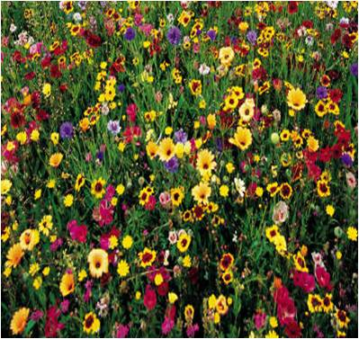
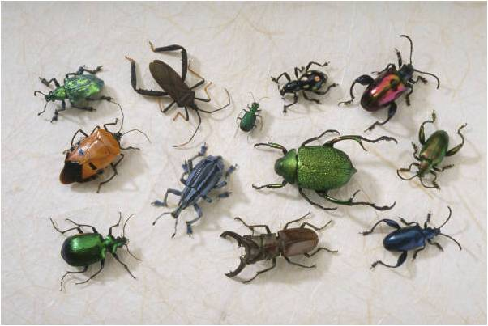
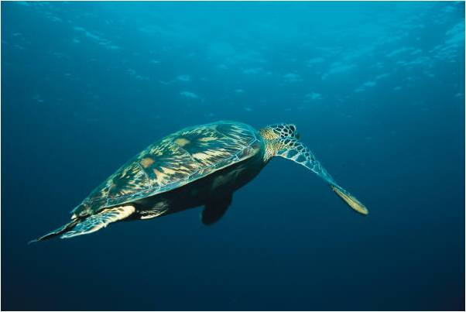
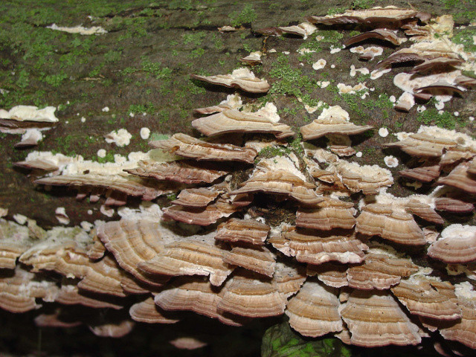
What is Biodiversity?
Photo Credit:
Fungi – USFWS
all others - PowerPoint clipart
Notes:
What is Biodiversity?
Biodiversity refers to the number of species and the number of individuals per species (also known as relative abundance) in a given geographic area. It includes all the different fungi, insects, plants, bacteria, mammals, reptiles, etc. living here. When we discuss the biodiversity of a given area (i.e. a rain forest in South America or the Gobi Desert), we are referring to all the species that live there and the number of individuals per species that are found there. In order to understand the biodiversity of a given area, we must take an inventory of what species are there and then get an idea of how many individuals per species there are. This is how we get an idea of those species that are doing well and those species that might be threatened or even endangered.
We can even calculate the biodiversity of one area and compare it to another using these numbers (i.e. this area is more diverse or less diverse than another area or this area was less diverse in 1980, but is more diverse in 2010).
Discussion questions:
What ecosystem to you think has lots of biodiversity? Why do you think it has so much biodiversity?
What ecosystem to you think has very little biodiversity? Why do you think it has so little biodiversity?

Slide 5
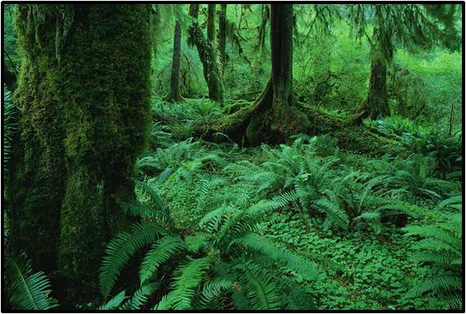
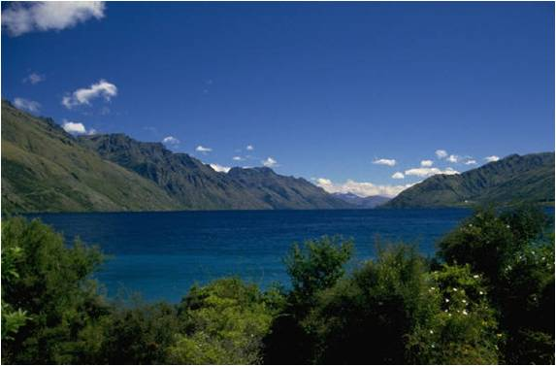
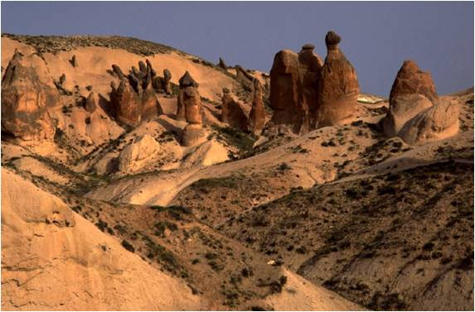
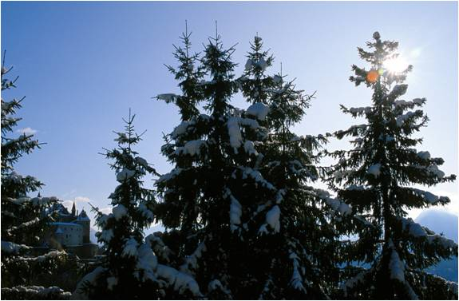
Why is Biodiversity Important?
Photo Credit:
PowerPoint clipart
Notes:
Why is biodiversity so important?
Practically –
Biodiversity allows for the recolonization of areas where a species has been extirpated (localized extinction). This means that individuals of the same species found in another area can come in and reestablish a population in the area where it was originally extirpated. In addition, a diverse large scale patchwork of ecosystems can act as barriers to natural disease and pest transmission between populations. Biodiversity also maintains genetic pools or reservoirs for species to rebound from things like diseases, pests, and even changes in their environment. Genetic diversity between individuals within the same population increases the chances of some individuals of that population surviving thus allowing the species to continue as a whole (the basis for natural selection). However, in species such as corn or other crops, there is not much diversity among individuals as they have been genetically breed for certain attributes thus resulting in genetically identical plants. These plants are at a great disadvantage when it comes to pests and diseases which is unfortunate as these are the plants that we rely on for food. Biodiversity also provides alternatives to the use of pesticides in our environment to control pest populations by offering predators and parasites to do the job instead.
Economically –
A diverse food supply means that should something happen (a pest or disease) to one part of the food supply, there can be a shift to other parts of the food supply. Biodiversity also provides an array of pollinators for our fruit supply. Biodiversity allows for the discovery of new medicinal remedies or therapies or drugs that have yet to be discovered. It also allows for jobs in the tourism industry (guides, fishing, hiking, viewing wildlife, snorkeling, diving, going to the beach and seeing the organisms that live there – all those things you like to do on vacation) and the television and movie industry (film sites and nature documentaries), just to name a few.
Aesthetically and emotionally -
Biodiversity allows for an appreciation of beauty which has no direct dollar value. How can you put a dollar value on watching a sunset or a sunrise over the sand dunes or the experience of seeing your first green eyed tree frog in the rainforest in person?
Discussion question:
Why do you think biodiversity is important?
Information sources:
Convention on Biological Diversity.
accessed June 15, 2012 –
http://www.biodiv.be/biodiversity/about_biodiv/importance-biodiv/
Ecological Society of America.
accessed June 15, 2012 –
http://www.esa.org/education_diversity/pdfDocs/biodiversity.pdf
U.S. Environmental Protection Agency.
accessed June 15, 2012 –
http://www.epa.gov/bioiweb1/aquatic/

Slide 6
What Changes the Biodiversity in an Area?
Weather events
Natural catastrophes
Climate change
Land conversion
Invasive species
Notes:
There are many causes for a change in the biodiversity of a given area. If you change the ecosystem itself, you will change the biodiversity of that ecosystem.
For example, a weather event such as a hurricane or flooding or tornadoes can alter an ecosystem and change the biodiversity found there (it decreases). In addition, events such as wildfires and volcanic eruptions can also alter the ecosystem and thus the biodiversity (again, it decreases). Given enough time, these ecosystems and their associated biodiversity could recover.
A change in the climate can also cause change in an ecosystem thus changing the biodiversity of that ecosystem. For example, in some grassland areas, the climate has become drier. This drier climate has caused the grassland to become a desert. This is known as desertification. This process does have a severe impact on the biodiversity found there (it decreases).
In geologic time, the earth has gone through many climatic changes that affected all ecosystems. Imagine how much the biodiversity of a given area changed during any of the ice ages (it decreased) or during the warming events that followed the ice ages (it increased).
Converting forested land to crop land also changes the biodiversity in the area. There may still be biodiversity in the area after the change, but it will be very different from the biodiversity that was originally there (usually it decreases). In addition, converting land to residential areas or malls or parking garages will affect the biodiversity (it decreases).
The introduction of invasive species can also change the biodiversity of an area. The following examples are of invasive species and their impact on an ecosystem (and its biodiversity).
Discussion question:
What other things do you think might affect biodiversity?

Slide 7
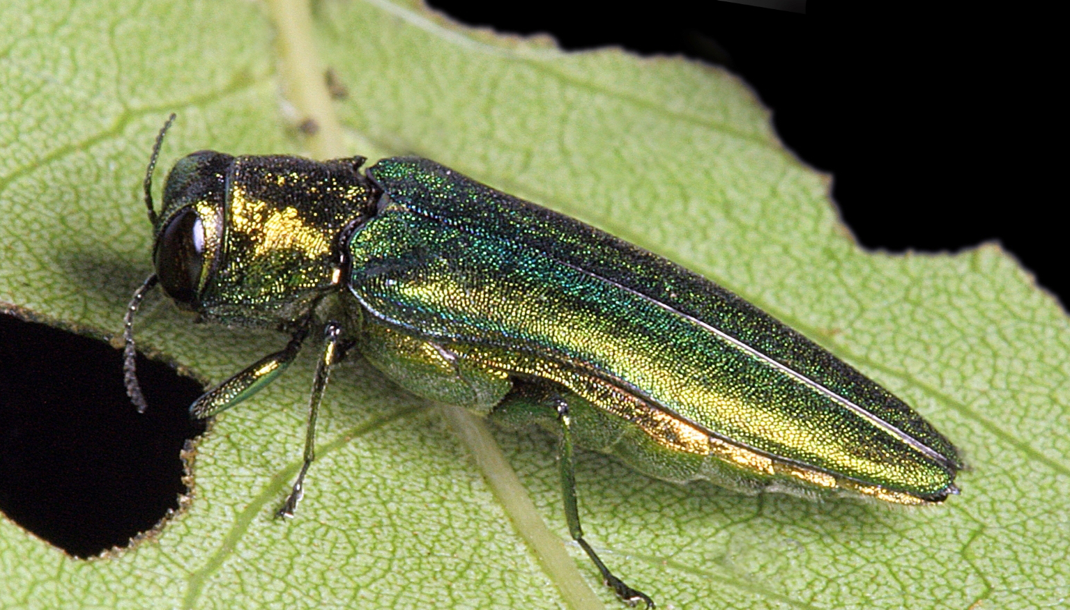
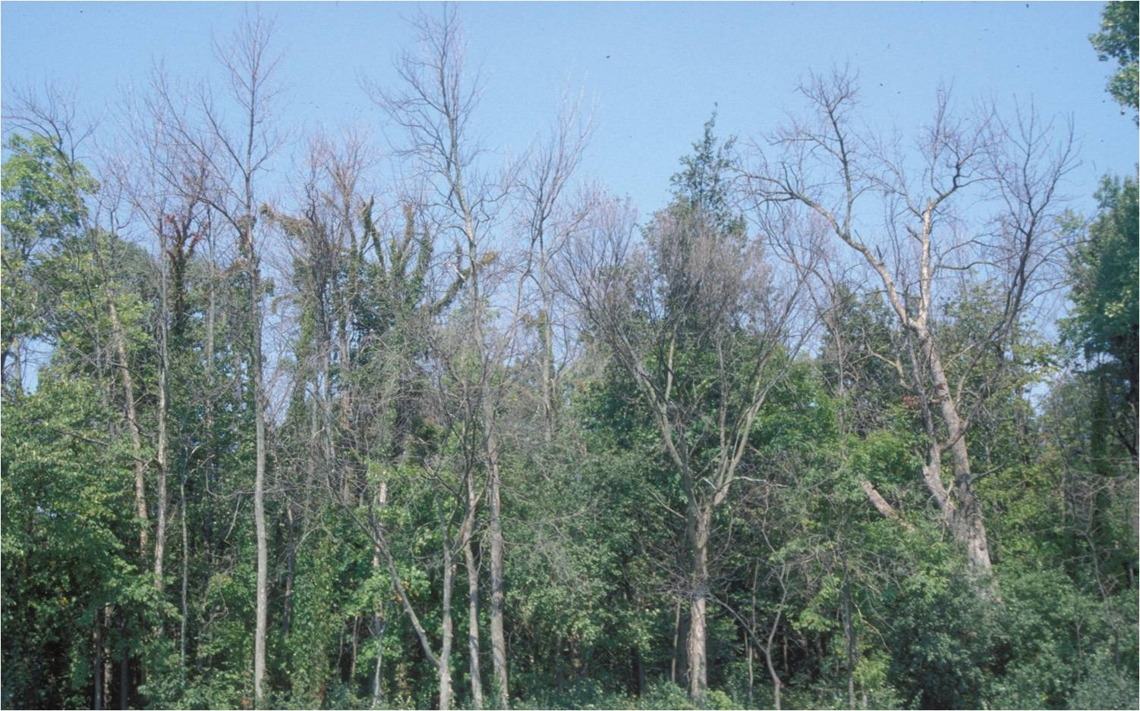
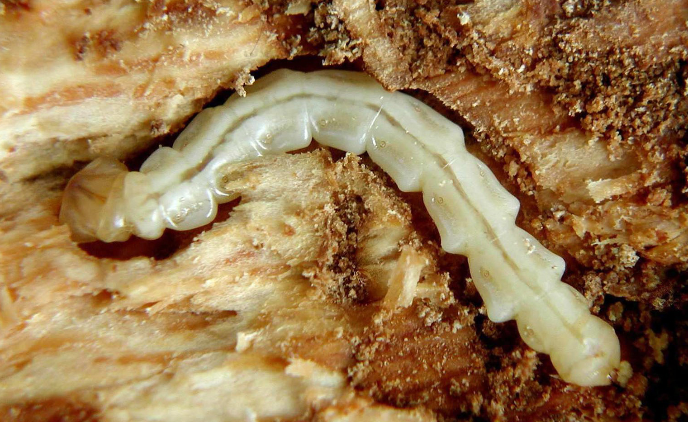
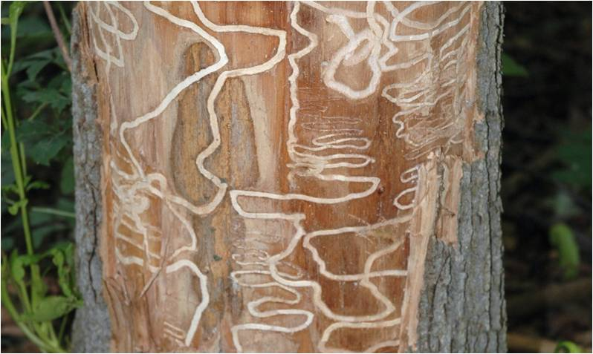
Invasive species in our natural ecosystems
Emerald ash borer
Photo Credit:
Damaged ash trees: Daniel Herms, The Ohio State University, www.bugwood.org, #5171038
Beetle: David Cappaert, Michigan State University, www.bugwood.org, #2106098
Larvae: David Cappaert, Michigan State University, www.bugwood.org, # 1460071
Tunnels: Art Wagner, USDA APHIS PPQ, www.bugwood.org, #5147090
Notes:
Invasive species are species whose introduction into an area does or is likely to cause economic harm (such as to a natural ecosystem or to agricultural systems) or harm to human health.
For example, the emerald ash borer (Agrilus planipennis) is a beetle that is native to Asia. It was first detected in Michigan in the summer of 2002 and has since spread to 19 states (Connecticut, Illinois, Indiana, Iowa, Kansas, Kentucky, Maryland, Massachusetts, Minnesota, Missouri, New Hampshire, New York, North Carolina, Ohio, Pennsylvania, Tennessee, Virginia, West Virginia, and Wisconsin). It is thought that they came in by accident on wood packing material made from ash trees in its native range.
The adults average 0.5 inch (1.25cm) long and are metallic green in color. The larvae reach about 1.5 inches (4cm) long, are creamy white, and are somewhat flattened. There segments look like a series of nested bells.
The adults feed on the leaves of the ash trees (Fraxinus spp.) that grow here with very little damage to the tree itself. However, its larvae burrow into the vascular tissues of the tree essentially starving the tree to death within a few years (vascular tissue carries food and water to all parts of the plant). The image above shows typical damage seen after an emerald ash borer infestation. Millions of ash trees have already been killed and millions more will die because of this invasive insect.
Discussion questions:
What do you think will happen to the biodiversity of an ash forest if this happens?
There are many ash trees planted in urban settings (parking lots, sidewalks, along roadways, in neighborhoods, etc.). What will be the impact of this insect on the biodiversity found there? What organisms could be impacted?
Information sources:
Emerald ash borer website.
accessed June 5, 2012 –
http://www.emeraldashborer.info/
Florida Department of Agriculture and Consumer Service, Division of Forestry. 1999. Forest Trees of Florida. Published in house.
NPDN First Detector Modules - Introduction to the Emerald Ash Borer and Identification and Hosts
accessed June 5, 2012 –
http://www.firstdetector.org
USDA Natural Resources Conservation Service – Plant Database. “Fraxinus”.
accessed June 6, 2012 –
http://plants.usda.gov/
USDA Pest Alert. “Emerald Ash Borer”.
accessed June 5, 2012 –
http://www.na.fs.fed.us/spfo/pubs/pest_al/eab/eab04.htm

Slide 8
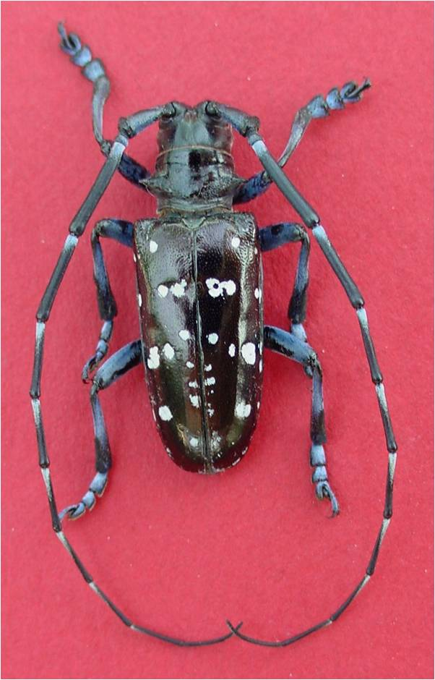
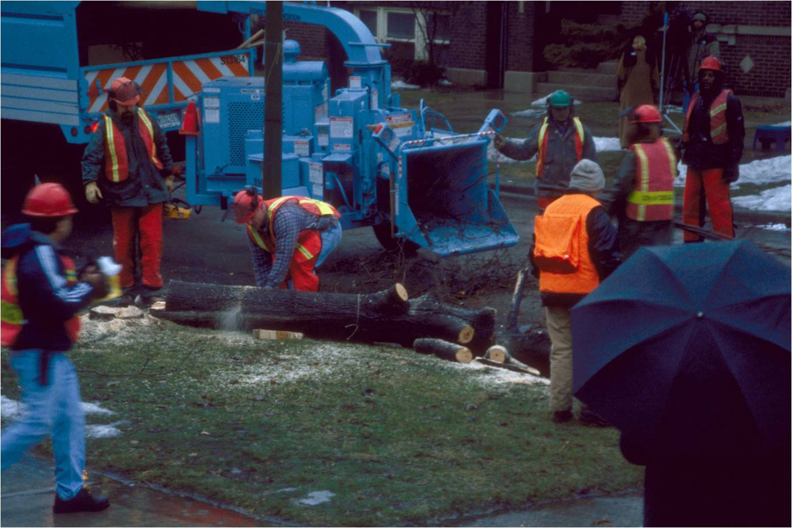
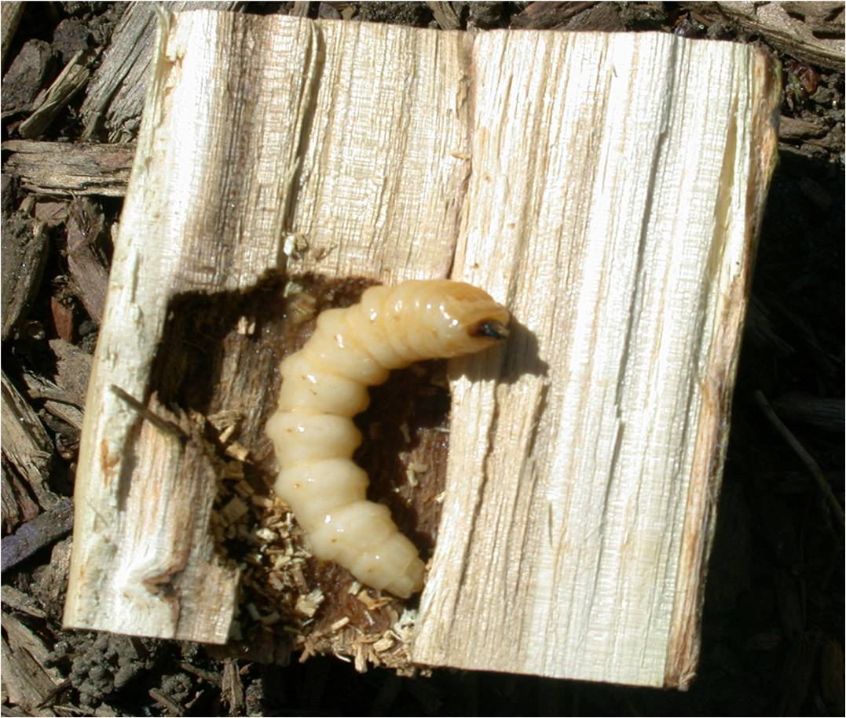
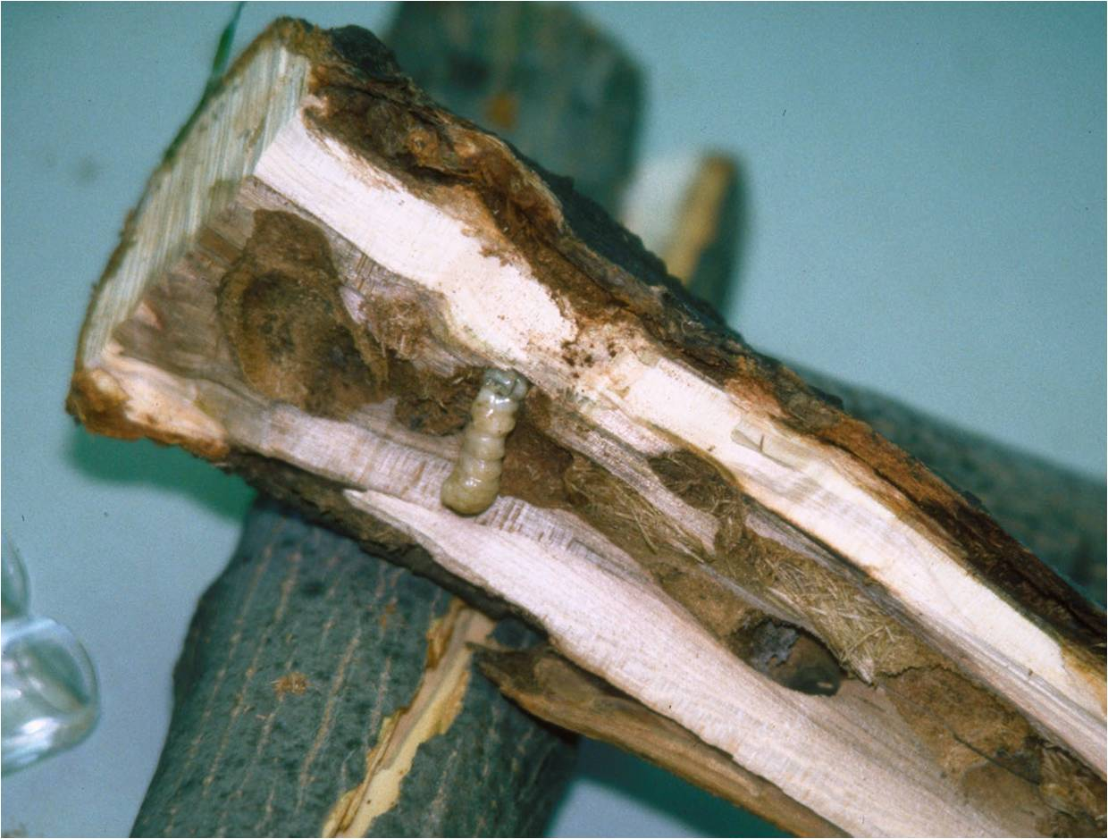
Invasive species in our natural ecosystems
Asian long horned beetle
Photo Credit:
Chipping trees: Larry R. Barber, USDA Forest Service, www.bugwood.org, #3047034
Beetle: Michael Bohne, www.bugwood.org, #1262001
Larvae: Thomas B. Denholm, New Jersey Department of Agriculture, www.bugwood.org, #1253027
Tunnels: Steven Katovich, USDA Forest Service, www.bugwood.org, #1398111
Notes:
Another example is the Asian long horned beetle (Anoplophora glabripennis). This species is also a native of China and was first detected in New York in 1996. It then spread to areas in Illinois, New Jersey, Massachusetts, and Ohio. It also probably came in accidently on wood packing material. Because there are isolated detections of this pest, an eradication effort is underway. As of September 1, 2013, this pest has been eradicated from Illinois and New Jersey, but populations remain in Ohio, New York, and Massachusetts (NAPPO September 2013).
The adults range between 1 to 1.5 inches (25 and 35mm) in length with long antennae that is 2.5 times the length of the body in males, and 1.3 times the length of the body in females. They are black with white spots. The larvae average 2 inches (50mm) long, are creamy white in color, and quite round in profile.
The larvae of this beetle tunnel into the tree where they feed in the vascular tissues of the tree causing the tree to die. They prefer maple (Acer spp.), but will also attack birches (Betula spp.), buckeye (Aesculus spp.), elms (Ulmus spp.), and willows (Salix spp.).
Currently, authorities are working on eradicating this insect where it is found by removing all trees that are infested. So far, thousands of trees have been cut down and either chipped or burned.
Discussion questions:
What do you think will happen to the biodiversity of a maple forest (birch forest or mixed hardwood forest to which all of these trees belong) if this insect is not eradicated?
There are many maples, birches, buckeyes, horsechestnuts, or willows planted in urban settings (parking lots, sidewalks, along roadways, in neighborhoods, etc.). What will be the impact of this insect on the biodiversity found there? What organisms could be impacted?
Information sources:
Asian Longhorned Beetle website –
accessed June 5, 2012 –
http://www.uvm.edu/albeetle/management/treeremoval.html
EPPO Data Sheets on Quarantine Pests. “Anoplophora glabripennis”.
accessed June 6, 2012 –
http://www.eppo.int/QUARANTINE/insects/Anoplophora_glabripennis/ANOLGL_ds.pdf
USDA Natural Resources Conservation Service – Plant Database. “Acer”, “Betula”, “Aesculus”, “Ulmus”, “Salix “.
accessed June 6, 2012 –
http://plants.usda.gov/
USDA Pest Alert. “Asian Longhorned beetle”.
accessed June 5, 2012 –
http://www.na.fs.fed.us/pubs/palerts/alb/alb_pa.pdf

Slide 9
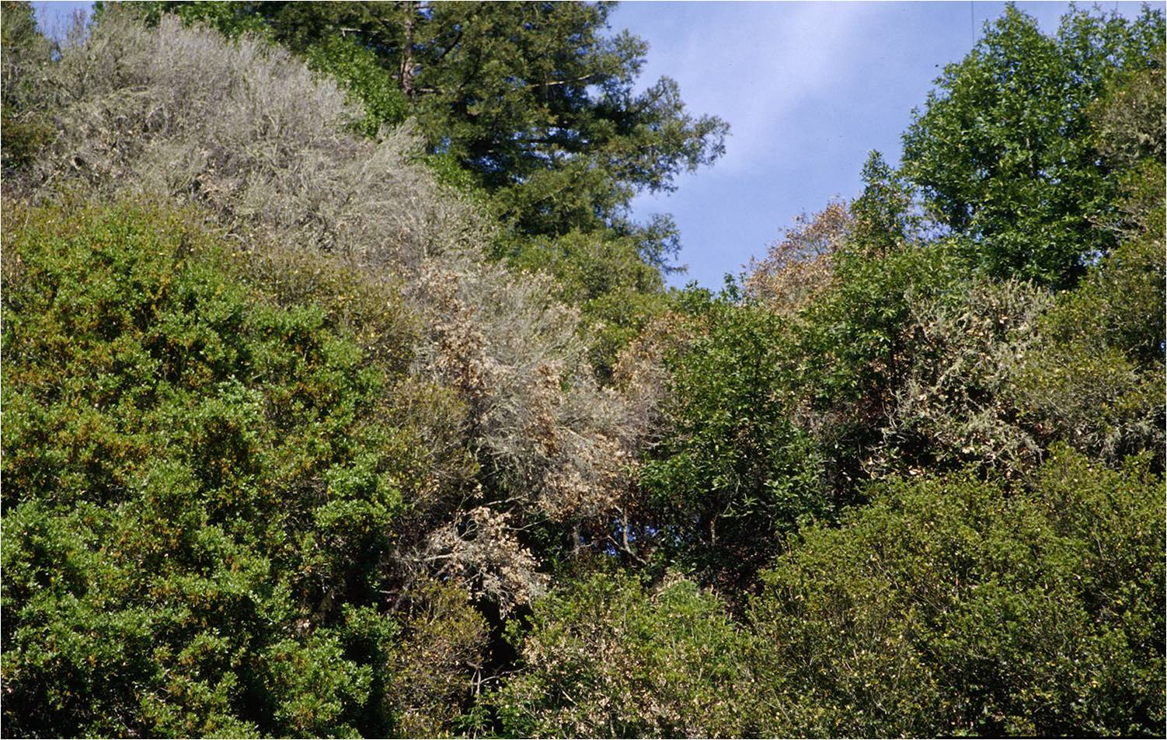
Invasive species in our natural ecosystems
Sudden oak death
Photo Credit:
Joseph O’Brien, USDA Forest Service, www.bugwood.org, #1427112
Notes:
An invasive disease that is taking its toll on the oaks in the western U.S. is sudden oak death (SOD). Sudden oak death (also known as ramorum leaf blight or ramorum dieback) is an invasive disease that is caused by a water mold called Phytopthora ramorum. Water molds look like fungi, but are actually more closely related to algae. Though researchers are still determining the native distribution of this disease, evidence suggests that it is not native to either North America or Europe (where it has recently been found).
Over 135 plants have been recorded as hosts for sudden oak death including many that are found in native forests, in the nursery trade, and in people’s yards. Though many plants, such as rhododendron, camellia, and viburnum can have the disease, but do not die from it, many others have no defense for this newly introduced disease and thus succumb to it.
This disease can kill a tree in one to two seasons and causes leaf death or cankers (large, weeping wounds). Spores that cause this disease are spread through rainwater, contaminated water, soil, and soil litter.
Discussion questions:
What do you think has happened to the biodiversity of oak forests in California?
What do you think will happen to other oak forests elsewhere in the United States if this disease spreads?
Do you see oak trees as you drive around town? If so, what could happen to the biodiversity of organisms that rely on these oak trees? What organisms do you think could be impacted?
Information sources:
California Oak Mortality Task Force. 2012.
accessed 6/14/2012 –
http://www.suddenoakdeath.org/diagnosis-and-management/hosts-and-associated-plants/
Garbelotto, M. 2004. “Sudden oak Death: A Tale of Two Continents”. Outlooks on Pest Management, Volume 15, Number 2, pp. 85-89.
USDA – APHIS. 2012.
accessed 6/14/2012 -
http://www.aphis.usda.gov/plant_health/plant_pest_info/pram/downloads/pdf_files/nationalpestalert_.pdf

Slide 10
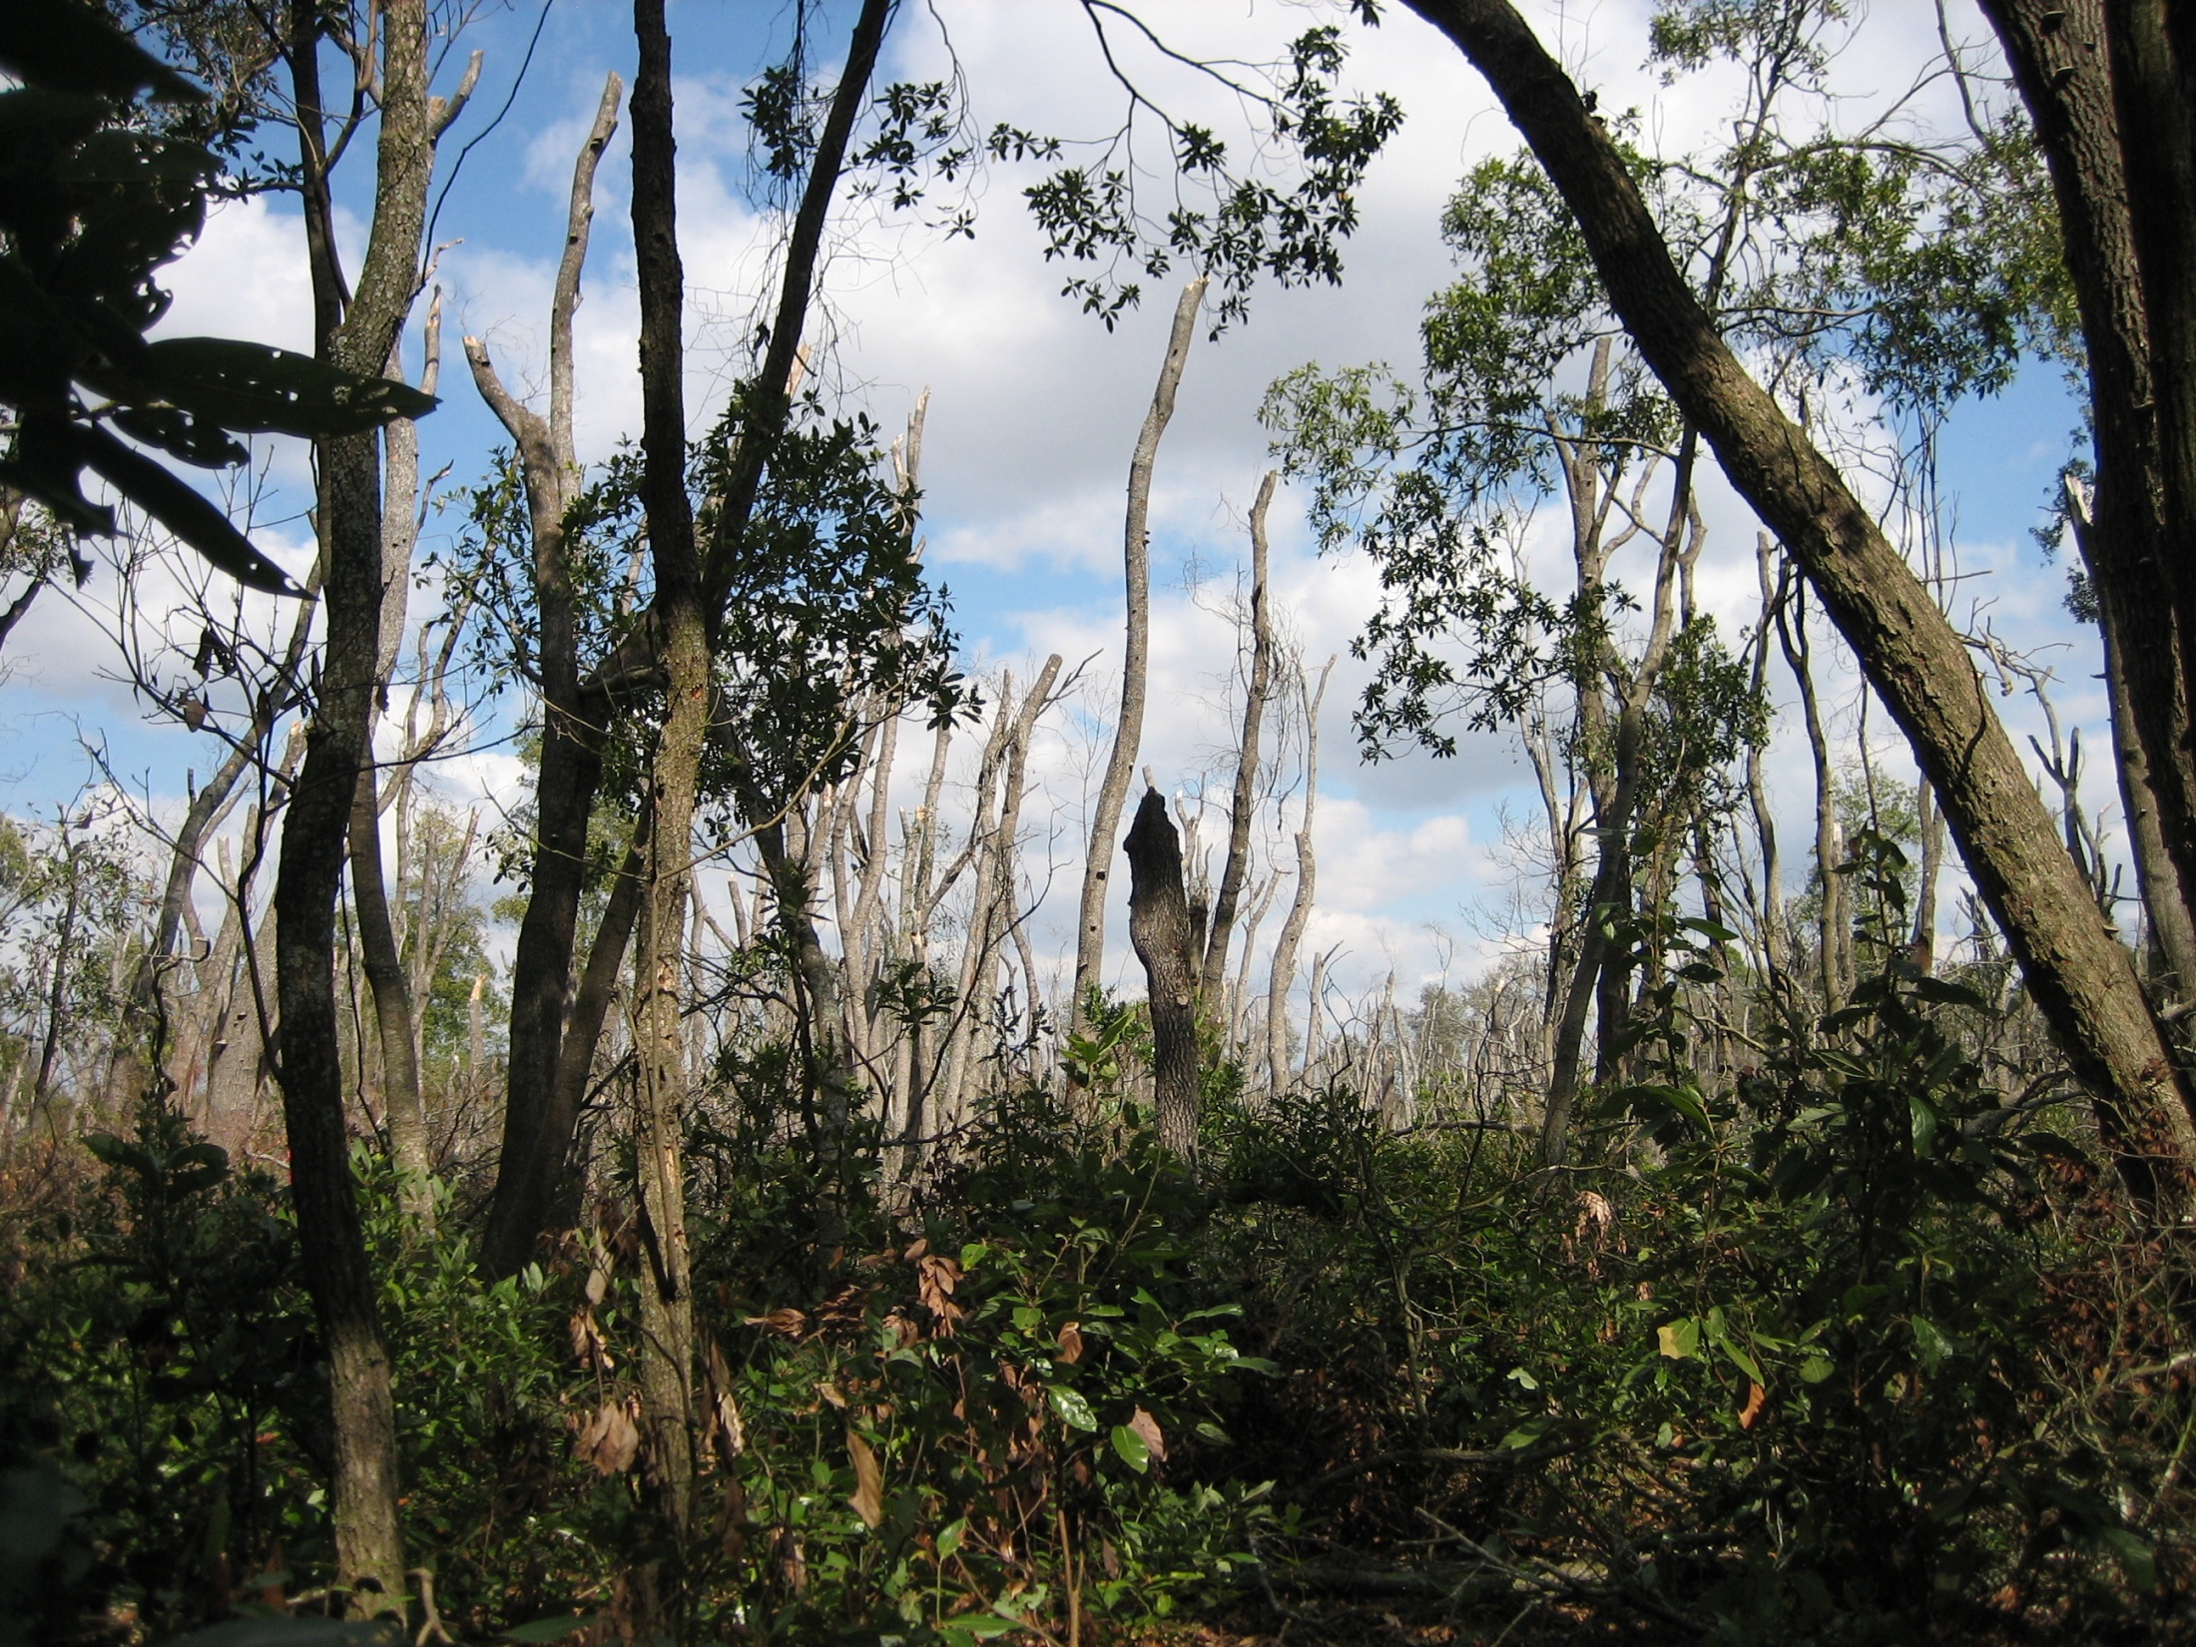
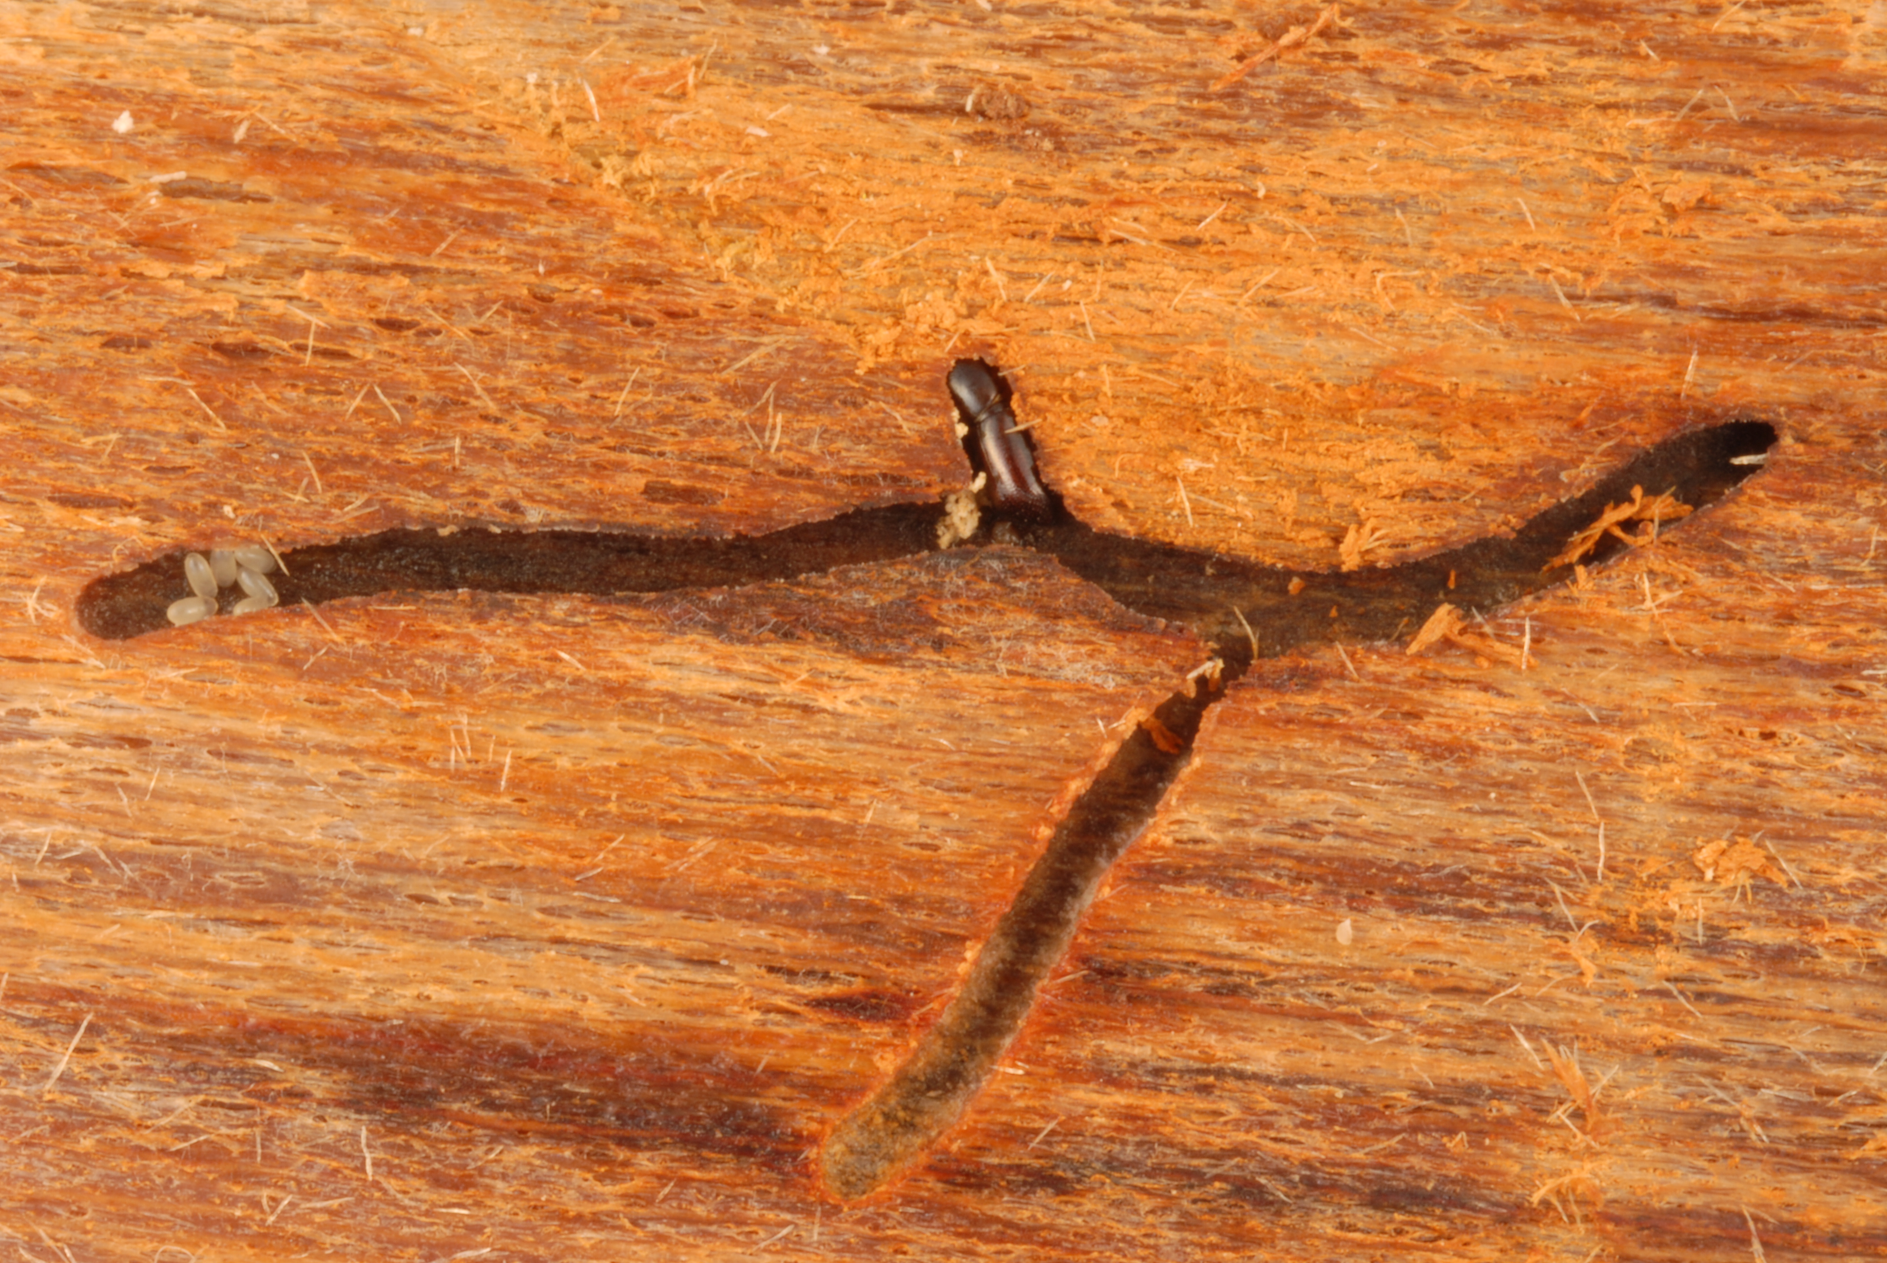
Invasive species in our natural ecosystems
Laurel wilt
Photo credits:
Damage: CL Harmon, University of Florida
Adult and tunneling: Lyle Buss, University of Florida
Notes:
Another invasive disease is laurel wilt which that is caused by a fungus (Raffaelea lauricola). It is spread by an invasive beetle from Asia called the redbay ambrosia beetle (Xyleborus glabratus). The beetle (and therefore the fungus that causes the disease) came into the U.S. most likely on wood packing material.
The adult of this beetle is tiny (averaging just 1/32inch or 2mm in length) and brown. You will probably never see this beetle, just the damage that it causes.
This disease attacks mostly redbay trees found in the southeastern United States. These trees produce fruit that is a very important source of food for wildlife in the winter. This disease also kills sassafras, swamp bay, pondspice, pondberry, camphor, and avocado.
The adults tunnel into the tree, bringing with it the fungus which it grows in the tree for food. This fungus then spreads throughout the tree and kills it. It was first detected in Georgia and has since spread to North Carolina, South Carolina, Florida, Alabama, and Mississippi. Once infected, a stand of mature redbays can be completely killed in 3 to 5 years.
There is currently no cure for the disease.
Discussion questions:
What do you think has happened to the biodiversity of a redbay forest in the southeastern United States?
What do you think will happen to the avocado industry if this disease spreads to their trees?
Information sources:
Alabama Forestry Commission. “Laurel Wilt Disease”.
accessed 6/14/2012 –
http://www.forestry.alabama.gov/LaurelWilt.aspx?bv=3
Florida Department of Agriculture and Consumer Services – Division of Forestry. 2008.
accessed 6/14/2012 –
http://www.floridaforestservice.com/publications/fh_pdfs/Laurel_Wilt.pdf
Jeff Eickwort, Forest Biologist, Florida Department of Agriculture and Consumer Services, Division of Forestry.
Fraedrich, S.W., T.C. Harrington, R.J. Rabaglia, M.D. Ulyshen, A.E. Mayfield, III, J.L. Hanula, J.M. Eickwort, and D. R. Miller. 2008. “A Fungal Symbiont of the Redbay Ambrosia Beetle Causes a Lethal Wilt in Redbay and Other Lauraceae in the Southeastern United States”. Plant Disease, Volume 92, No. 2.

Slide 11

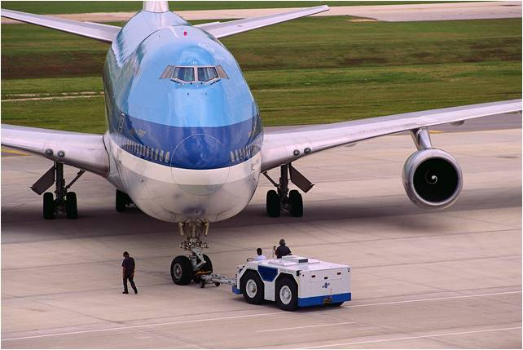
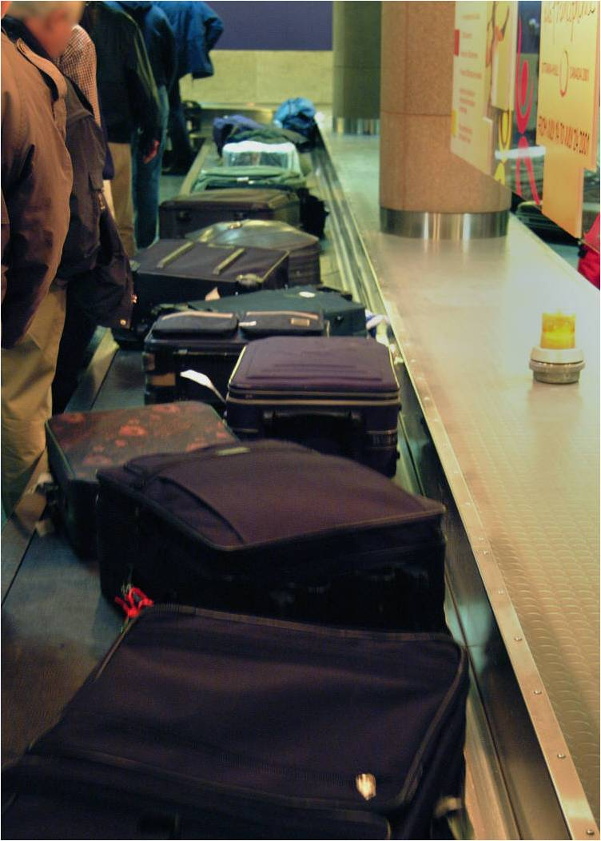
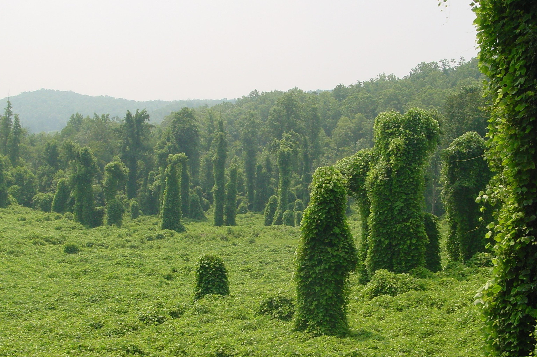
How are invasive species introduced?
Photo Credit:
Kudzu: Kerry Britton, USDA Forest Service, www.bugwood.org, #0002156
And PowerPoint clip art
Notes:
Most of the invasive pest and disease introductions that have affected our ecosystems have occurred through accidental or unintentional pathways. In some cases, however, intentional introductions have occurred though the consequences of these introductions were not known at the time. This is especially true of what we consider weedy plants. We bring in plants for their horticultural or ornamental value, but once the plant became established in its new environment - that’s when it’s weed potential became known. This is what happened with kudzu. It was brought in as a forage crop for livestock and then used to help stabilize soil in the southeastern United States. However, this plant quickly took over parts of the southeastern United States where it smothers trees and other vegetation with its sheer volume and coverage thus altering the ecosystem drastically.
Accidental invasive species introductions have increased in recent years due to:
increased international commercial trade of various plant-based commodities or products that could harbor plant pests (i.e. shipping and cargo coming in on planes)
For example, exotic plant pests can arrive on imported fruits and vegetables, nursery plants shipped from offshore locations, seeds, solid wood packing material, products made from plants such as decorative pine cones, and even ceramic tile (i.e. this was due to the packing and shipping method, not because the tile was composed of a plant product)
human travel patterns in which unintentional hitchhikers are moved as people travel from place to place
For example, seeds, eggs of insects, etc. can come in on the muddy shoes you didn’t have time to clean and just threw in your luggage or maybe you brought back a souvenir made from the seeds or other parts of a local plant, etc.
the intentional transport of plant propagation material and animals by private citizens that either are unaware of or ignore the regulations.
For example, perhaps you brought some fruit and nuts with you that you wanted to snack on later during your plane ride back to the United States or that you wanted to share with your friends back home or maybe you collected seeds from a really cool plant that you saw on vacation and wanted to plant it in your yard at home.
There are some species that we already know will present problems should they enter the United States. In fact, USDA-APHIS-PPQ maintains a list of diseases and toxins known to cause problems elsewhere in the world that they feel will have a major impact on things like our food supply should they become established here (we will discuss a few of them later). It is important to remember that most invasive insects are not a problem in their native range as they usually have predators or diseases that keep their populations in check. It is when they are removed from these natural population controls that their own population grows out of control. In addition, in their native range the plants or animals that would normally be impacted by these pests or diseases have evolved their own defense against them over time thus mitigating their affects. However, in a new habitat with a plant or animal that has no defense against them, an exotic pest or disease can have devastating affects.
Discussion question:
Can you think of other ways that invasive species can come into the U.S.?
Information sources:
Gullino, M.L., J. Fletcher, and J.P. Stack. 2008. Crop biosecurity: definitions and role in food safety and food security. In Crop Biosecurity: Assuring our Global Food Supply. Gullino, M.L., J. Fletcher, A. Gamliel, J.P. Stack. (eds).
Halbert, S. 2004. Pathways for the introduction of exotic pests: a Florida perspective. Entomological Society of America Annual Conference, Salt Lake City, UT. Abstract.
Accessed June 15, 2012 -
http://esa.confex.com/esa/2004/techprogram/paper_14325.htm
Pimental, D., R. Zuniga, and D. Morrison. 2004. Update on the environmental and economic costs associated with invasive species in the United States. Ecological Economics. 52: 273-288.
USDA-APHIS-PPQ guidelines for pathway surveys
Accessed June 15, 2012 –
http://caps.ceris.purdue.edu/guidelines/2011/nsg
USDA – Forest Service. “Kudzu”
Accessed June 15, 2012 –
http://www.invasive.org/weedcd/pdfs/wow/kudzu.pdf

Slide 12
Who monitors for invasive species?
Department of Homeland Security - Customs and Border Protection (DHS-CBP)
United States Department of Agriculture - Animal and Plant Health Inspection Service – Plant Protection and Quarantine (USDA-APHIS-PPQ)
Cooperative Agricultural Pest Survey Program (CAPS Program)
State Departments of Agriculture
Others
You
Notes:
Many state and federal government agencies are involved in plant biosecurity. These agencies are concerned with invasive species that can come into this country and damage the plants that grow here. They monitor for invasive pests and diseases as part of a national plant biosecurity program. This monitoring includes things like inspection of imported plant materials at shipping ports and airports by the Department of Homeland Security - Customs and Border Protection (DHS-CBP). Only about 2% of all imports of fruits and vegetables are inspected though. DHS-CBP are also the people who ask you if you have brought in any fruits or vegetables from another country when you come back to the United States.
While DHS-CBP can inspect almost everything that comes into the United States, United States Department of Agriculture - Animal and Plant Health Inspection Service – Plant Protection and Quarantine (USDA-APHIS-PPQ) retains the responsibility of inspecting all imported plants that are to be used for planting or propagation purposes. They are also responsible for federal quarantines, regulations, and international trade issues.
The Cooperative Agricultural Pest Survey Program (CAPS Program) is coordinated by USDA-APHIS and partners with the State Departments of Agriculture to serve as a second line of defense against entry of harmful plant pests and weeds through surveys targeted at specific pests. The CAPS program surveys for exotic species that may have arrived into the U.S. (maybe through imported commodities) but have not yet been reported or detected. There is also a network of laboratories (usually at land grant universities) and scientists that are used to help identify possible exotic pests and diseases and to help send that information to others that are involved in plant biosecurity. This network is called the National Plant Diagnostic Network.
In addition, county extension agents, park or natural resource managers, private crop consultants or advisors, Master Gardeners, Master Naturalists, and other professionals aid in the detection of invasive pests and diseases that could affect our natural and human maintained ecosystems.
You can also help by being observant and diligent and reporting any unusual pest or pathogen damage to your local extension agent. They will know who to contact from there.
Information sources:
Homeland Security News Wire. 2009.
Accessed June 15, 2012 –
http://www.homelandsecuritynewswire.com/improving-inspections-agricultural-products

Slide 13
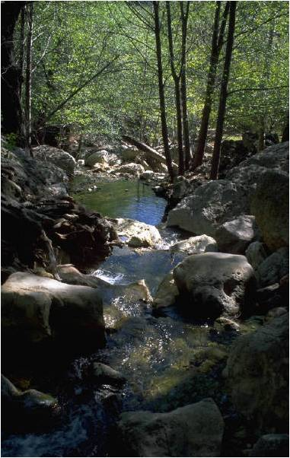
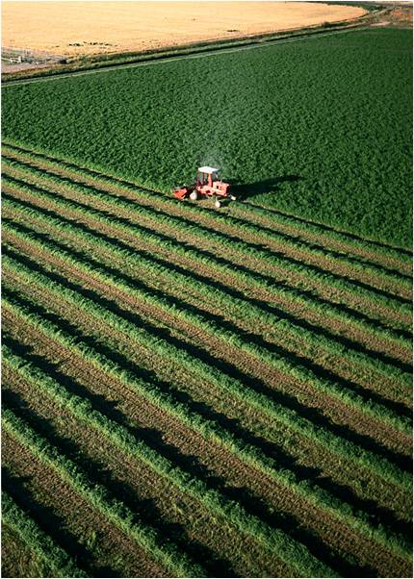
What does plant biosecurity have to do with my pizza?
Photo Credit:
PowerPoint clipart
Notes:
The people who are involved with plant biosecurity are also concerned about invasive species that can harm the plants we grow for food (agriculture) or in nurseries (ornamental plants and plants used in the floral trade).
Being able to grow our own food is very important to the health of our population. According to choosemyplate.gov, adults should eat between 5 and 8 ounces (142 to 227 grams) of grains everyday while children need between 3 and 7 ounces (85 to 198 grams) a day. Research has shown that a diet inclusive of whole grains reduces heart disease, diabetes, diverticular disease, and constipation. Because having access to grains is so important in maintaining a healthy diet, the U.S. planted 59.17 million acres and harvested over 2.2 billion bushels of wheat in 2009-2010.
Adults should also eat between 2.5 and 3 cups of vegetables everyday while children need between 1 and 3 cups a day. In addition, adults should eat between 1.5 and 2 cups of fruit everyday (children need between 1 and 2 cups a day) and 3 cups of dairy everyday (children need 2-3 cups a day). Research shows that a diet that includes fruits and vegetables provides essential vitamins (such as Vitamin A, Vitamin C, and folate), minerals (such as Potassium and Iron), and fiber which reduces the risk of chronic diseases, strokes and coronary artery disease, and certain cancers. Research has also shown that a diet inclusive of dairy products reduces the risk of osteoporosis and high blood pressure.
What about protein? We get our protein from beans, meat, eggs, nuts and seeds, and fish. Choosemyplate.gov recommends adults eat 5 to 6.5 ounces of protein everyday (children need 2 to 6 ounces per day). Protein is an important building block of bones, muscles, cartilage, skin, and blood. In fact, it is an important component of every cell you have.
Because having access to fruit, vegetables, dairy products and protein is also important in maintaining a healthy diet, the U.S. planted almost 4 million acres and harvested over 60.4 billion pounds of fruits and nuts in 2008. We also planted over 6.6 million acres and harvested over 128 billion pounds of vegetables in 2008. In addition, we produced almost 177 million pounds of milk and almost 94 billion mounds of red meat and poultry in that same year.
Discussion Questions:
1) Have you ever thought about where the local grocery store gets the food that you eat?
2) Have you ever thought about how much food we consume as a country?
Information sources:
USDA Chose my Plate.
Accessed June 15, 2012 -
http://www.choosemyplate.gov
CDC Fruit and Vegetable Benefits –
Accessed June 15, 2012 -
http://www.fruitsandveggiesmatter.gov/benefits/index.html
The Learning Channel.
accessed June 15, 2012 -
http://recipes.howstuffworks.com/fresh-ideas/healthy-dinners/health-benefits-of-dairy-ga.htm
WebMD.
accessed June 15, 2012 -
http://www.webmd.com/fitness-exercise/guide/benefits-protein
USDA Economic Research Service –
Accessed June 5, 2012 –
Fruit and Tree nut Yearbook - http://usda.mannlib.cornell.edu/usda/ers/./89022/2009/index.html
Vegetable and Melons Yearbook - http://usda.mannlib.cornell.edu/MannUsda/viewDocumentInfo.do?documentID=1212
Livestock and Dairy - http://www.ers.usda.gov/publications/ldp/LDPTables.htm
Wheat - http://www.ers.usda.gov/data/wheat/YBtable01.asp

Slide 14

For example…
Photo Credit: Stephanie Stocks, University of Florida
Notes:
So what do all those numbers mean to you?
Let’s look at this in terms of a pizza. It has pepperoni, spinach, bell peppers, onions, tomato sauce, and cheese on it (my favorite!) and the crust is made from wheat.
In order for you to eat this delicious pizza, the U.S. produced 680 million pounds of spinach in 2007 (which generated $164 million). The U.S. also produced 1,468 million pounds (and $468,387,000) of green peppers, 7,963 million pounds (and $816,061,000) of onions, and almost 29 billion pounds (and $2,070,484,000) of tomatoes that same year. In addition, the U.S. produced 21,962 million pounds of pork (some of which was used in our pepperoni) and 9777 million pounds of cheese in 2007. The amount of wheat produced in the U.S. in 2007 was 2,051 million bushels.
What other agricultural products would you add to your pizza? Pineapple? Canadian Bacon? What if you wanted anchovies? Where do they come from?
However, as much as we produce, we also import food in order to feed our growing population. The U.S. imported 21 million pounds of spinach, 1,371 million pounds of bell peppers, more than 902 million pounds of onions, 2,360 million pounds of tomatoes, 968 million pounds of pork, almost 355 million pounds of cheese, and 86 million bushels of wheat in 2007.
Discussion questions:
What could happen to the local food supply if we accidentally import an invasive pest or disease of these products when we import the product itself from another country?
What if we accidentally introduce one when we try to bring in fruit or vegetables from another country when we travel?
Information sources:
USDA Economic Research Service –
Accessed June 5, 2012 –
Spinach - http://www.ers.usda.gov/News/spinachcoverage.htm
Bell peppers, onions, and tomatoes - http://www.ers.usda.gov/Catalog/CatalogByTopicID.asp?SON=TRUE&SBY=TITLE&PDT=1&ARC=C&TID=660
cheese - http://future.aae.wisc.edu/data/annual_values/by_area/178?tab=production and http://www.fas.usda.gov/psdonline/circulars/Dairy.pdf
Pork - http://www.ers.usda.gov/Publications/AgOutlook/AOTables/
Wheat - http://www.ers.usda.gov/data/wheat/YBtable01.asp

Slide 15
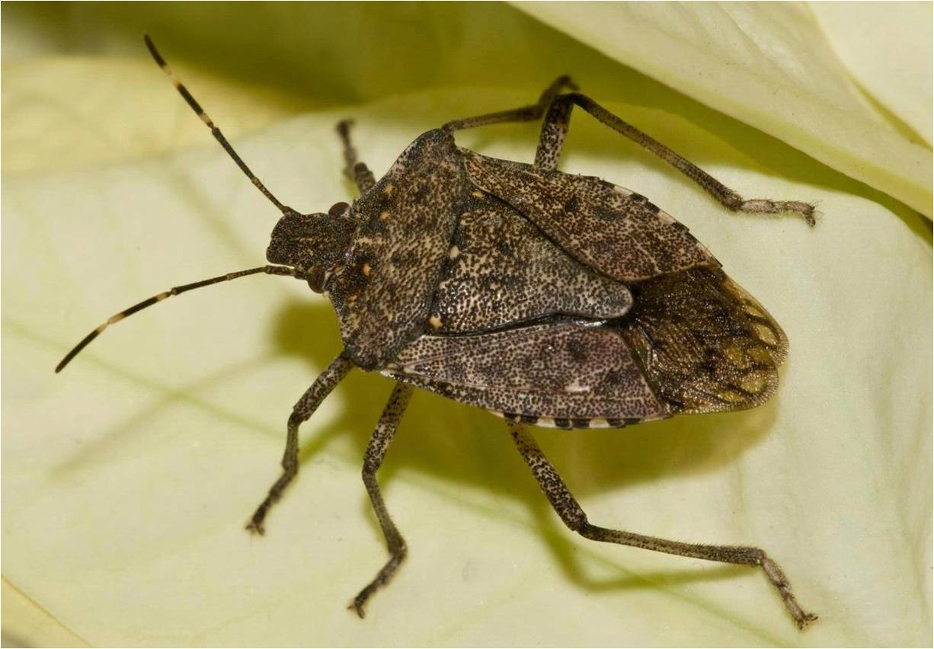
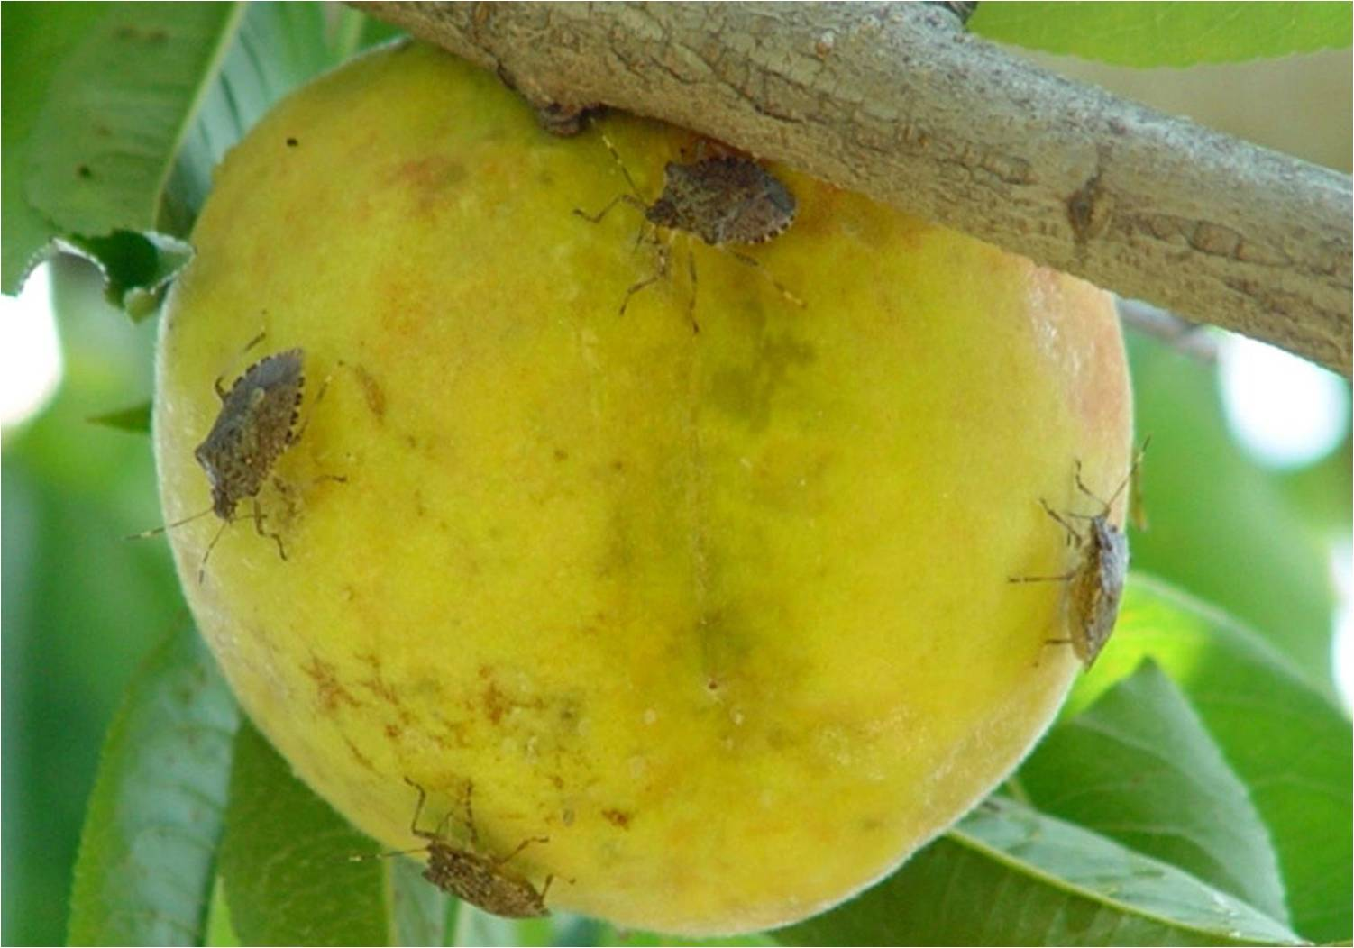
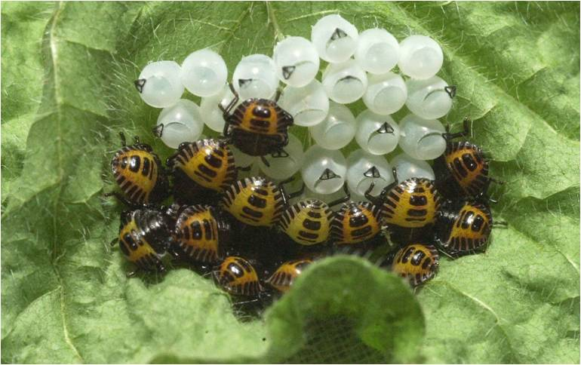
Invasive species that affect agriculture
Brown marmorated stink bug
Photo credit:
adult: Susan Ellis, www.bugwood.org, #5369380
Egg and nymphs: David R. Lance, USDA APHIS PPQ, www.bugwood.org, #1460052
On fruit: Gary Bernon, USDA APHIS, www.bugwood.org, #1113016
Notes:
The brown marmorated stink bug (Halyomorpha halys) is an invasive species that was first detected in Allentown, Pennsylvania in 2001. It is native to Asia where it is a known pest of many crop species including apple, cherry, fig, peaches, and pears as well as many ornamental plants. No one is quite sure how this insect arrived in the United States.
This insect averages 0.5 inch (12 to 17mm) long and has alternating light and dark bands on the antennae and along the outer edge of the body. It has a long piercing, sucking mouthpart (indicated by the yellow arrow). It uses its mouthpart to suck plant juices which leads to plant injury and decline, making the plant vulnerable to plant diseases. When it feeds on fruit in particular, they cause such damage that the fruit cannot be harvested for you to eat.
It has the potential to become a major pest of crops throughout the United States. It has already caused problems with apple and peach production in 2010 in the Northeastern U.S. The distribution of the brown marmorated stink bug in the U.S. continues to spread, but it is not yet considered established in every state. Your local Cooperative Extension service would have more information in regards to this pest’s establishment.
It also has a tendency to overwinter in your home which makes it a nuisance and it is called a stink bug because of the scent that it produces-it stinks.
There were more than 2 million acres of fruit trees used in commercial production in the United States in 2009. These trees produced over 59.6 million pounds (and almost $14 billion) of fruit.
Discussion questions:
What could be the impact on the fruit tree industry if the brown marmorated stink bug became established in the U.S.?
Would you be upset if there were no apples, cherries, fig, peaches, or pears to eat? What could happen if you did not have access to fig newtons or apple pie or peach cobbler or cherry garcia ice cream?
Information sources:
University of Maryland Extension Service – “Brown Marmorated Stink Bug”
accessed June 17, 2012 –
http://www.hgic.umd.edu/content/brownstinkbug.cfm
University of Florida Featured creatures – “Brown Marmorated Stink Bug”.
Accessed June 6, 2012 –
http://entnemdept.ufl.edu/creatures/veg/bean/brown_marmorated_stink_bug.htm
USDA – Economic Research Service
accessed June 17, 2012 -
Fruit and Tree Nut Yearbook -http://usda.mannlib.cornell.edu/MannUsda/viewDocumentInfo.do?documentID=1377
USDA News and Events. “Combating the Brown Marmorated Stink Bug: A New Threat for Agriculture,
a Nuisance for Homeowners”
accessed June 5, 2012 –
http://www.ars.usda.gov/is/AR/archive/jul09/bug0709.htm

Slide 16
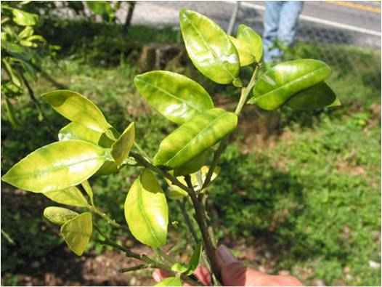
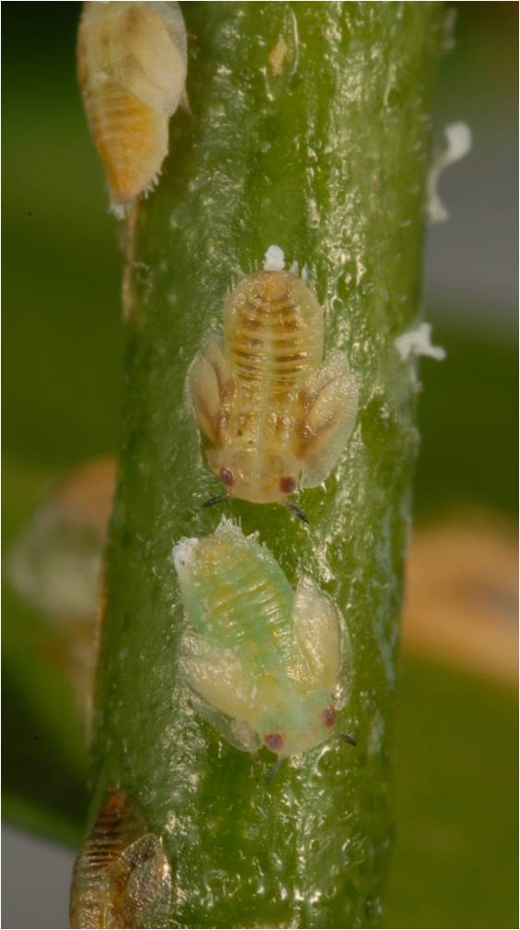
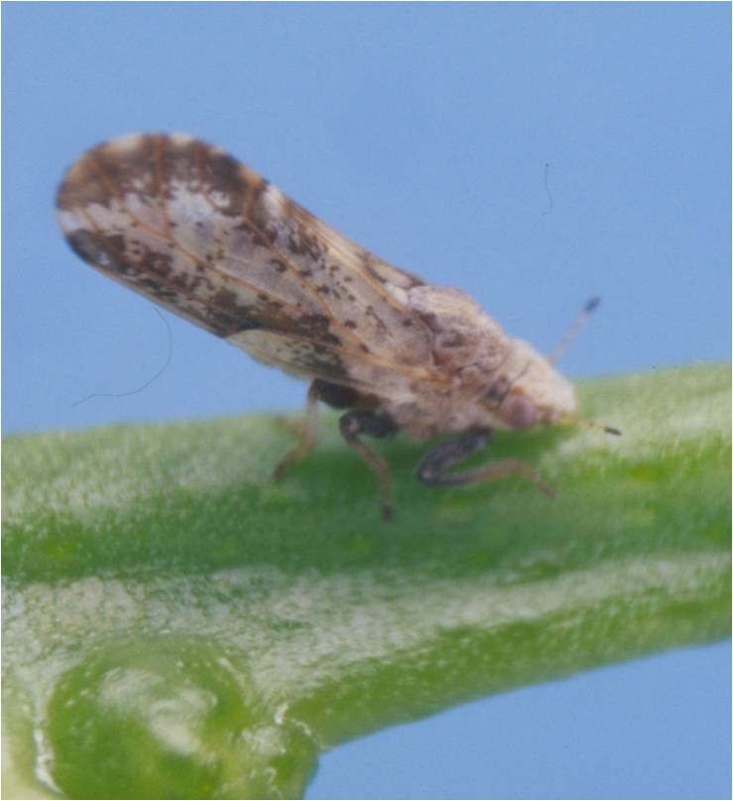
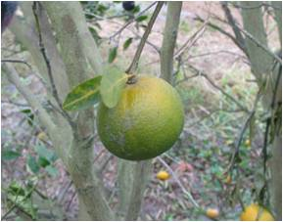
Invasive species that affect agriculture
Citrus Greening
Photo credit:
Larvae: Lyle Buss, University of Florida
All others: Florida Department of Agriculture and Consumer Services, Division of Plant Industry –
http://www.freshfromflorida.com/pi/chrp/greening/cgphotos.html
Notes:
Citrus greening is example of an invasive disease. It was recently detected in Florida (2005) that has now been detected in California, Louisiana, Georgia, South Carolina, and Texas. This disease was already known to cause problems for citrus in Saudi Arabia, Central and South America, tropical and subtropical Asia, and the Caribbean basin. It was on the USDA-APHIS-PPQ Select Agents and Toxins list before it was detected in Florida.
Citrus greening is a bacterial disease (caused by Candidatus Liberibacter asiaticus) that is vectored (or transmitted) by an invasive insect, the Asian Citrus Psyllid (Diaphorina citri), which was detected in Florida in June 1998 and has spread to other states (California, Texas, Arizona, South Carolina, Georgia, Alabama, Mississippi, and Louisiana). No one is sure how the disease and the vector were introduced into the United States, but it was most probably introduced by humans illegally bringing plants into the U.S. It is a major pathogen of concern for all U.S. citrus-producing states (Texas, Arizona, California, and Texas) as there is currently no cure for the disease. So far, the disease has not been detected Arizona; however, the vector of the disease is already established there.
The disease degrades the phloem tissues of the tree (those that move food from the leaves to the roots) causing yellowing of leaves on the tree and rapid decline in plant health. It also causes the fruit to be small, unevenly colored (stays green), and makes the juice of the fruit very bitter.
The U.S. has more than 851,000 acres of citrus which produced almost 26 billion pounds and around $3.2 billion in the 2008 growing season. In cases where citrus greening and its vector have gone unchecked, up to 95% of the trees became infected with a yield reduction of 30-100%.
Discussion questions:
Florida is the biggest citrus producer in the U.S. (responsible for 65% of all citrus produced). What do you think the impact of this disease could be on you having access to orange juice or key lime pie, not to mention the crisp citrus scent of cleaning products?
What do you think are the odds of the disease showing up in Arizona?
Information sources:
Florida Department of Agriculture and Consumer Services – Division of Plant Industry Pest Alert. “ Citrus Greening/Huanglongbing)”.
accessed June 17, 2012 –
http://www.freshfromflorida.com/pi/pest-alerts/huanglongbing.html
Gottwald, T.R. J.V. Garca, and R.B. Bassanezi. 2007. “Citrus Huanglongbing: The Pathogen and Its Impact”. Plant Health Progress.
accessed June 17, 2012 –
http://www.apsnet.org/publications/apsnetfeatures/Pages/HuanglongbingImpact.aspx
Protect U.S. scripted presentation. “Citrus Greening and the Asian Citrus Psyllid”
Accessed June 17, 2012 –
http://www.protectingusnow.org
USDA – Economic Research Service
accessed June 17, 2012 -
Fruit and Tree Nut Yearbook -http://usda.mannlib.cornell.edu/MannUsda/viewDocumentInfo.do?documentID=1377

Slide 17
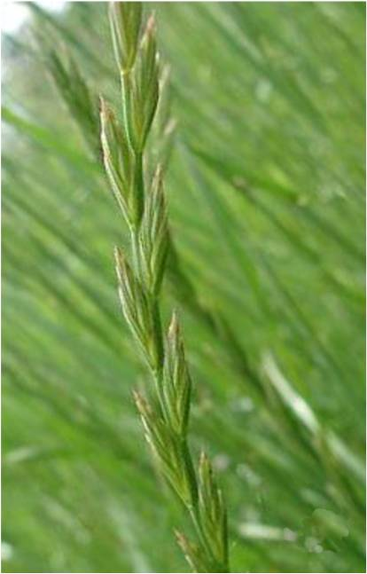
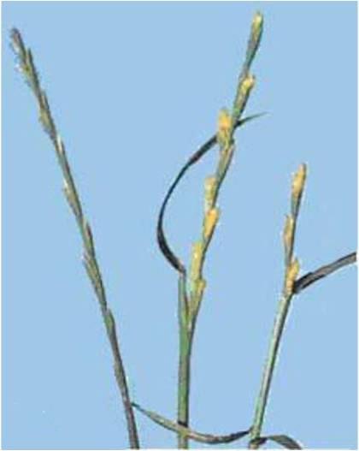
Invasive species that affect agriculture
Gumming Disease
Left: Healthy rye
Right: infected rye
Photo credit:
http://www.ars.usda.gov/SP2UserFiles/Place/00000000/opmp/RathayibacterPoisoningFeb2010.pdf
Notes:
An invasive disease that has not become established in the U.S. (yet) is gumming disease. It is currently on the USDA-APHIS-PPQ Select Agents and Toxins list.
This disease is caused by a bacteria (Rathayibacter toxicus) and is found in Australia and New Zealand and South Africa. It affects mainly rye, but also other grasses that are typically used as forage for livestock. The disease is spread by infected seed and gall nematodes (Anguina spp. of which several species in this genus are found in the U.S.). The bacteria produce corynetoxins (see the yellow tips in the right hand image) which are among the most lethal naturally produced poisons. Animals that consume infected grasses or seed suffer neurological symptoms, toxicosis, and death. Humans can also be impacted if they eat infected seeds or cereals or animals with the disease.
The U.S. planted over 1.2 million acres of rye which produced 7.4 million bushels and around $39 million in the 2010 growing season. Susceptible animals in the U.S. include the approximately 95 million cattle ($73 billion beef industry and $35 billion dairy industry), 6 million sheep ($542 million in lamb and wool industry), and 9 million horses ($40 billion equine industry).
The loss of human life is incalculable.
Discussion question:
What could be the impact on the livestock industry if gumming disease became established in the U.S.?
What do you think might be the impact of this disease on our pizza?
Information sources:
Center on Globalization Governance and Competitiveness. “A Value Chain Analysis of the U.S. Beef and Dairy Industries”.
accessed June 17, 2012 –
http://www.cggc.duke.edu/environment/valuechainanalysis/CGGC_BeefDairyReport_2-16-09.pdf
Oregon State University Extension Service. “Gumming Disease and Rye Grass Toxicity”.
accessed June 17, 2012 -
http://www.science.oregonstate.edu/bpp/Plant_Clinic/Disease_sheets/Rathayibacter%20toxicus.pdf
Recovery Plan For Rathayibacter Poisoning Caused by Rathayibacter toxicus (syn. Clavibacter toxicus) -
accessed June 17, 2012 –
http://www.ars.usda.gov/SP2UserFiles/Place/00000000/opmp/RathayibacterPoisoningFeb2010.pdf
Shiflett, Julie Stepanek. 2008. Sheep Industry Economic Impact Analysis. Prepared for the American Sheep Industry Association.
National Economic Impact of the U.S. Horse Industry
accessed June 17, 2012-
http://www.floridahorse.com/2005ahcstudy.html
USDA – Economic Research Service
accessed June 17, 2012 -
Rye data - http://www.ers.usda.gov/data/wheat/YBtable02.asp

Slide 18
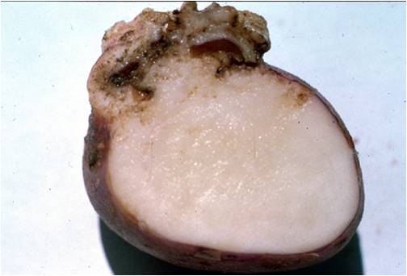
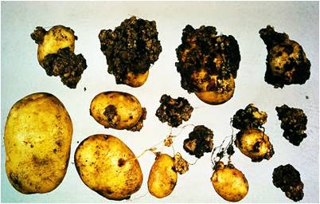
Invasive species that affect agriculture
Potato wart disease
Photo credits:
Central Science Laboratory, Harpenden Archive, British Crown, www.bugwood.org, #0454023 and Michael Hampson, http://www.ars.usda.gov/SP2UserFiles/Place/00000000/opmp/PotatoWart70109.pdf
Notes:
Potato wart disease is another example of a known disease that agencies and farmers are concerned about coming into the country. It is also currently on the USDA-APHIS-PPQ Select Agents and Toxins list.
It is caused by a fungus (Synchytrium endobioticum). This disease has spread throughout the world through trade and is one of the most devastating diseases of potato. It is found throughout Europe, large parts of Asia, parts of Africa, South America, and New Zealand. There have been outbreaks in the U.S. (in Pennsylvania, Maryland, and West Virginia), but eradication was declared successful in 1974. Because the fungal spores can persists for up to 40 years in the soil, you cannot replant potatoes in that field again for many years (after an infected crop) nor can the land have any crops planted on it that will be exported. The primary method of spread of this disease is through infected seed potatoes or the movement of infect soil.
The U.S. planted 1.02 million acres of potatoes which produced almost 40 million pounds and around $3.5 billion in the 2010 growing season.
Discussion question:
What could be the impact on the food you eat everyday if potato wart disease became established in the U.S. (i.e. what foods are made from potatoes)?
Information sources:
Caribbean Pest Information Network Pest Alerts.
accessed June 17, 2012 –
http://www.caripestnetwork.org/vtt/docs/datasheets/fungi/snchytrium_endobioticum.pdf
EPPO Data Sheets on Quarantine Pests. “Synchytrium endobioticum”.
accessed June 17, 2012 –
http://www.eppo.org/QUARANTINE/fungi/Synchytrium_endobioticum/SYNCEN_ds.pdf
USDA-ARS Potato Wart Disease Recovery Plan
accessed June 17, 2012-
http://www.ars.usda.gov/SP2UserFiles/Place/00000000/opmp/PotatoWart70109.pdf
USDA – Economic Research Service
accessed June 17, 2012 –
Vegetable and Melons Outlook - http://www.ers.usda.gov/publications/vgs/VGSTables.htm

Slide 19
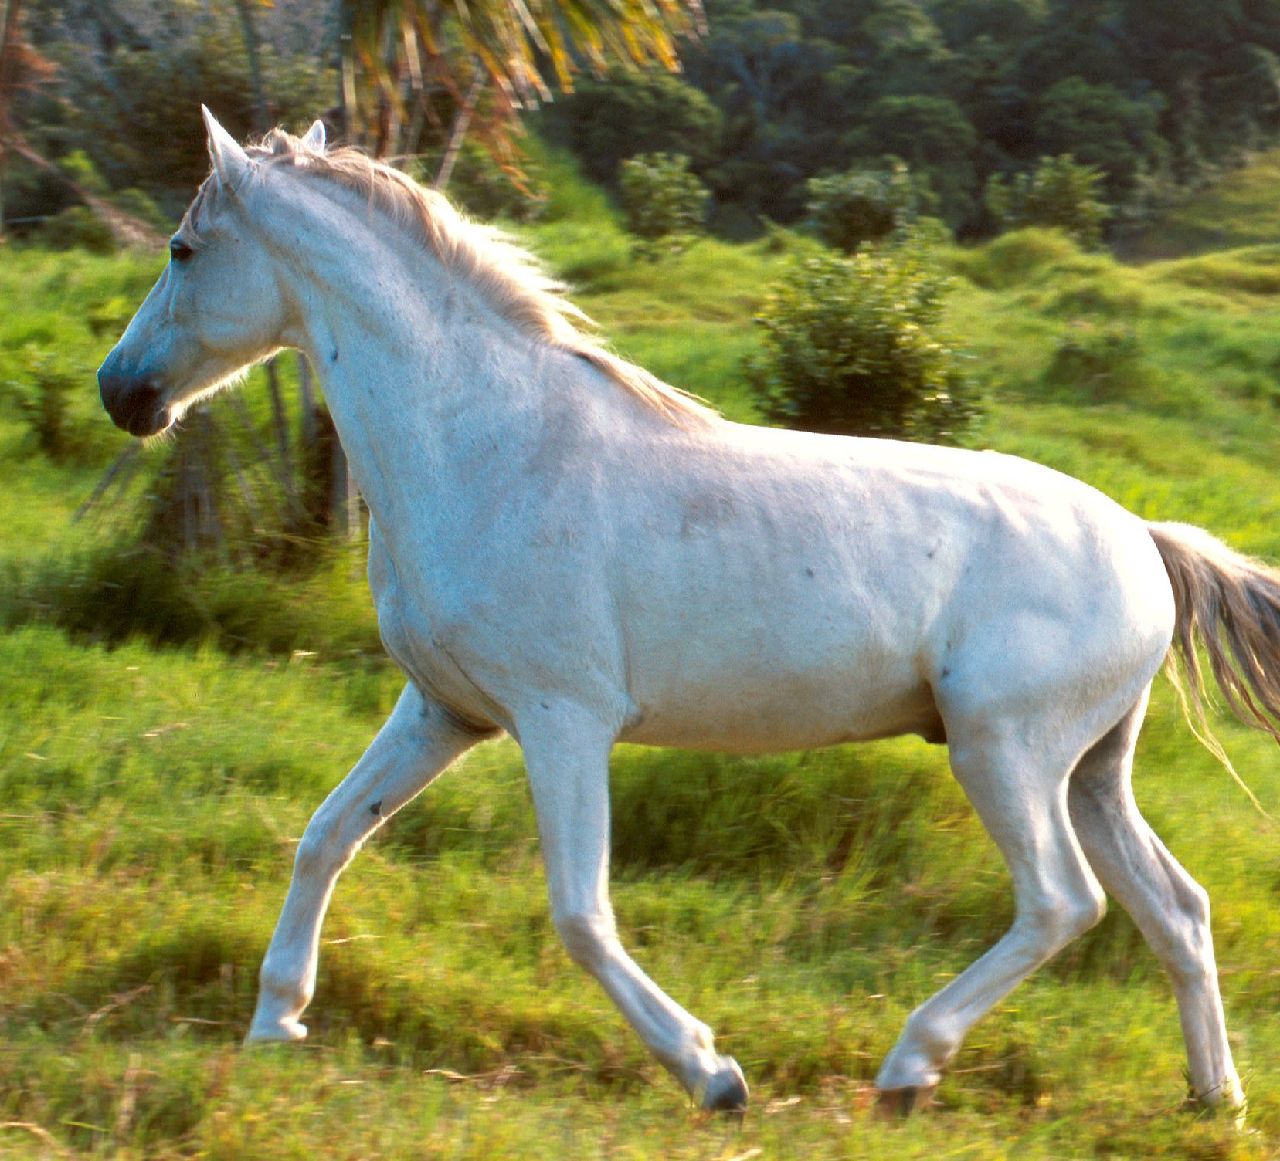
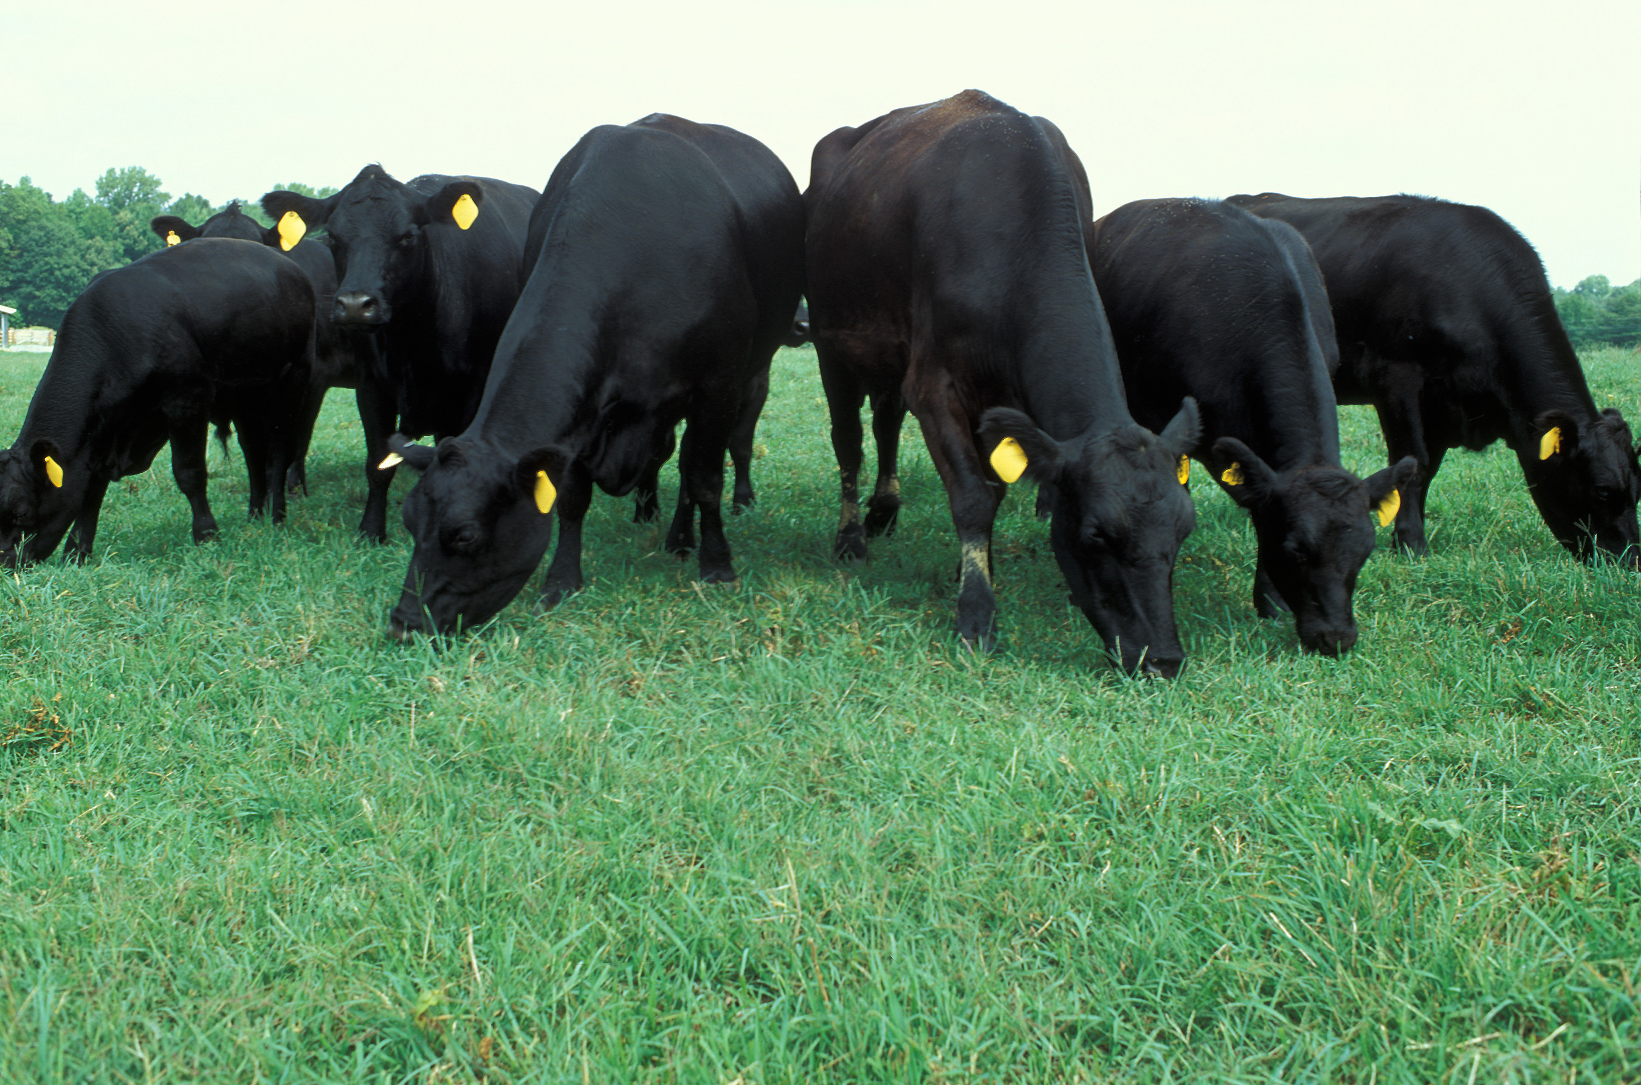
What if someone introduced an invasive pest or disease on purpose?
Glanders, anthrax, and rinderpest were introduced on purpose during both World Wars
Photo Credit: Scott Bauer, USDA-ARS, USDA-ARS Image Gallery,
http://www.ars.usda.gov/is/graphics/photos/, Image No. k8855-1 and No. k4148-10
Notes:
While most introductions of invasive pests and diseases are accidental or unintentional, the purposeful introduction of an invasive pest or disease with the intention of disrupting or destroying our food supply is viewed as an act of terrorism and is referred to as agroterrorism. Plant biosecurity is also concerned with agroterrorism.
There have been several documented historical cases of agroterrorism that have occurred in the 20th century.
For example, in World War I, Germany distributed bacterial cultures of Burkholderia mallei to undercover agents in an attempt to infect livestock being shipped to the Allies. This bacteria causes glanders which is a contagious and fatal disease that affects horses, donkeys, and mules in particular, but can also be transmitted to other mammals, including humans (either through direct contact with infected fluids or by eating meat from an infected animal that has not been properly cooked). The disease causes fever, chills, muscle aches, and sticky yellow discharge from nasal passages. Infection of the blood, localized infections, pulmonary infections, and even chronic infection can occur with this disease. In World War II, the Japanese forces used it and it has been suggested that this was also used against the mujahideen in Afghanistan in the 1980s (though this use was limited). It is interesting to note that although no naturally occurring case of glanders has been seen in the U.S. since the 1940s, it is commonly seen in domestic animals in Africa, Asia, the Middle East, and Central and South America.
Another example of agroterrorism involves anthrax which is a disease caused by the bacteria Bacillus anthracis. In livestock, the disease usually results in the death of the animal within 1 to 3 days. By the time the symptoms are seen, it is usually too late to save the animal. This disease can also be spread to humans through direct contact with spores found in animal products and from eating infected animals. It has 3 forms: cutaneous, gastrointestinal, and inhalation. Symptoms range from blisters (cutaneous anthrax) to nausea, bloody diarrhea, fever, and stomach pain (gastrointestinal anthrax) to cold or flu like symptoms (inhalation anthrax). Anthrax is a naturally occurring disease that is somewhat common in tropical countries such as Africa, South and Central America, southern and eastern Europe, Asia, the Caribbean, and the Middle East. It has also been seen occasionally in the United States. The Germans also used this in World War I against the allies and their trading partners. Japan used this disease against its enemies as well during World War II. The infamous Unit 731 conducted biological warfare research and human experimentations using these as well as other deadly diseases.
Finally, Rinderpest is a viral disease that is highly contagious among cattle, domesticated buffalo, and some wildlife (it does not cause disease in humans). It varies in severity from fever and sudden death to fever with congestion and nasal discharges, and lesions. It was not a full scale problem in the Western hemisphere, but it was devastating to Europe, Africa, and Asia. Japan was accused of using rinderpest against its enemies as part of the biological warfare research conducted by Unit 731 during World War II. Collaborative efforts have strived for global eradication of this disease. Through the advancing technology of vaccines and international surveillance of the disease, it was announced that the Global Rinderpest Eradication Programme (GREP) successfully eliminated the disease on June 28, 2011 during the UN FAO Conference; the campaign ran from 1945 – 2011. This is the first animal disease to be eradicated, and the second disease overall to be eradicated in history (the first being smallpox).
Discussion question:
Remember that the U.S. has approximately 95 million cattle ($73 billion beef industry and $35 billion dairy industry), 6 million sheep ($542 million in lamb and wool industry), and 9 million horses ($40 billion equine industry). Do you think it was worth the effort to try to eradicate this disease?
Information sources:
Arizona Department of Health Services. Bureau of Emergency Preparedness and Bioterrorism. “History of Biowarfare and Bioterrorism”
Accessed June 17, 2012-
http://www.azdhs.gov/phs/edc/edrp/es/bthistor2.htm
Centers for Disease Control and Prevention. “Anthrax”.
accessed June 17, 2012 –
http://www.bt.cdc.gov/agent/anthrax/
Centers for Disease Control and Prevention. “Glanders”.
Accessed June 17, 2012 –
http://www.cdc.gov/nczved/divisions/dfbmd/diseases/glanders/
Croddy, E., J. Wirtz, and J. Larsen, editors. 2004. Weapons of Mass Destruction, an Encyclopedia of Worldwide Policy, Technology, and History
accessed June 17, 2012 –
http://books.google.com/books?id=ZzlNgS70OHAC&printsec=frontcover&dq=weapons+of+mass+destruction+and+encyclopedia&hl=en&ei=bg0mTaj8LMSp8Aa3xeiNAg&sa=X&oi=book_result&ct=result&resnum=1&ved=0CCMQ6AEwAA#v=onepage&q&f=false
Iowa State University. Center of Food Security and Public Health. “Rinderpest”.
accessed June 17, 2012 –
http://www.cfsph.iastate.edu/Factsheets/pdfs/rinderpest.pdf
Parker, R., C. Mathis, M. Looper, J. Sawyer. “Anthrax and Livestock”. New Mexico State University College of Agriculture and Home Economics.
accessed June 17, 2012 –
http://aces.nmsu.edu/pubs/_b/B-120.pdf
Redmond, C., M.J. Pearce, R.J. Manchee, and B.P. Berdal. 1998. Deadly Relic of the Great War”. Nature, vol. 393, pp. 747-748.
accessed June 17, 2012 –
http://www.nature.com/nature/journal/v393/n6687/full/393747a0.html
Scientific Correspondence. “First Shots Fired in Biological Warfare”. Nature, vol. 395, p. 213.
accessed June 17, 2012 –
http://www.nature.com/nature/journal/v395/n6699/pdf/395213a0.pdf
Srinivasan, A., C.N. Kraus, P.M. Becker, J.D. Dick, L. Spacek, J.G. Bartlett, and D.L. Thomas. 2001. “Glanders in a Military Research Microbiologist”. The New England Journal of Medicine.
accessed June 17, 2012 -
http://www.nejm.org/doi/full/10.1056/NEJM200107263450404

Slide 20
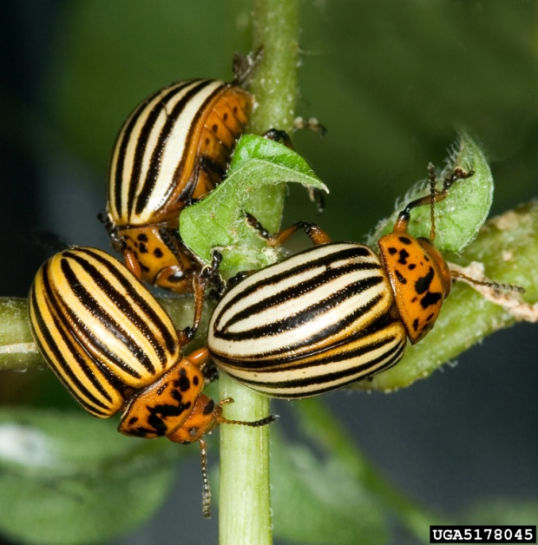

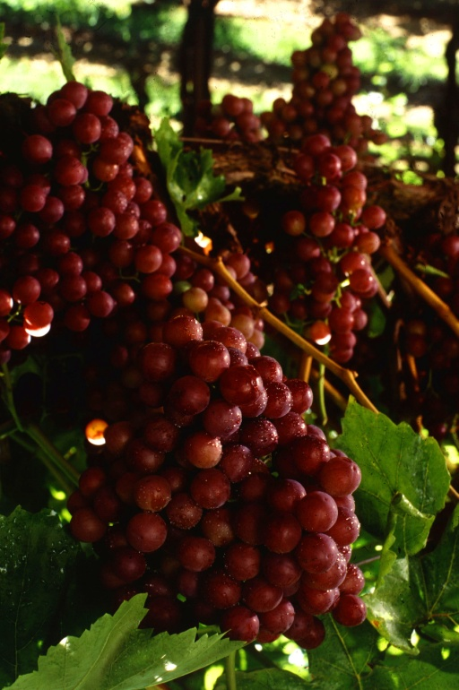
What if someone tried to destroy a crop on purpose?
Colorado potato beetle, Mercury poisoning oranges, and pesticide poisoning of grapes
Photo Credit:
Beetles: David Cappaert, Michigan State University, http://www.bugwood.org/, #5178045
Oranges: USDA-ARS Image Gallery, http://www.ars.usda.gov/is/graphics/photos/, #K3644-12
Grapes: Patrick Tregenza, USDA-ARS, USDA-ARS Image Gallery,
http://www.ars.usda.gov/is/graphics/photos#K5632-3
Notes:
Germany was accused of dropping cartons of Colorado Potato Beetle, Leptinotarsa decemlineata, onto Southern England’s agricultural crops during World War II. Colorado Potato Beetle is a major pest of potato and other solanaceous crops (such as tomatoes). Germany apparently began a large scale breeding program in 1943 and conducted field research on deploying the beetle from aircraft over their own fields to see how well the beetle would disperse. It did not seem to occur to them that they may be intentionally infecting their own fields as a result of their field trials.
Introducing pests and diseases are not the only ways to disrupt food supplies. In 1978, the Arab Revolutionary Council used mercury to poison Israeli oranges by rubbing it onto the skin of the fruit in an attempt to cause economic harm to Israel. Twelve people got sick (including children in West Germany and Holland where the oranges where exported). A 40% reduction in orange exports from Israel occurred. It is important to remember that any type of terror, including agroterrorism, includes not only a human component, but an economic component.
Although we often think of pesticides in terms of their benefits for pest control, they could also be potentially utilized as a weapon in agroterrorism. In 1997, Israeli individuals in Gosh Etzion sprayed pesticides on grapevines in two Palestine villages. Approximately 17,000 metric tons of grapes were destroyed causing economic hardship to that region.
Information sources:
Carus, W.S. 2002. Bioterrorism and Biocrimes: The Illicit Use of Biological Agents since 1900.
accessed June 17, 2012- http://books.google.com/books?id=1jEP8Ve4zwgC&printsec=frontcover&dq=bioterrorism+and+biocrimes&hl=en&ei=Ow0mTfSNJIK88gbftvCWAQ&sa=X&oi=book_result&ct=result&resnum=1&ved=0CCsQ6AEwAA#v=onepage&q&f=false
Garrett, B.C. 1996. “The Colorado Potato Beetle Goes to War”. Historical Note No. 2.
accessed June 17, 2012-
http://www.sussex.ac.uk/Units/spru/hsp/documents/CWCB33-Garrett.pdf
Karasik, T.W. 2002. Toxic Warfare
accessed June 17, 2012 –
http://books.google.com/books?id=zoDbDBsAMHIC&printsec=frontcover&dq=toxic+warfare&hl=en&ei=sg0mTdb1DIO78gaWjYnXAQ&sa=X&oi=book_result&ct=result&resnum=1&ved=0CCYQ6AEwAA#v=onepage&q&f=false
Murphy, P.J. 2004. The Wolves of Islam: Russia and the Faces of Chechen Terror. Brassey’s, Inc., Dulles, Virginia.
University of Minnesota Center for Infectious Disease Research and Policy. “Overview of Agricultural Biosecurity”.
accessed June 17, 2012 –
http://www.cidrap.umn.edu/cidrap/content/biosecurity/ag-biosec/biofacts/agbiooview.html

Slide 21

Crop Concerns – History or News?
Photo Credit:
PowerPoint clipart
Notes:
The outbreak of E. coli in Germany during the late spring and early summer of 2011 is an example of the impact that a disruption of the food supply can have.
As of June 16, 2011, 39 people had died and 3300 people were sickened from contamination of vegetable sprouts. The loss of human life cannot be measured, but the economic losses that resulted from this interruption in the food supply can be. When Germany announced on May 26 that they suspected cucumbers from Spain as the culprit, export of Spanish produce ground to a halt (as did the consumption of the produce). Some countries (such as Russia) even banned the importation of Spanish produce all together. As the outbreak progressed, other countries (such as Russia) banned the importation of vegetables from all 27 European Union member states.
Spanish exporters alone estimate that they lost $290 million a week. While Germany announced that they were not sure about Spanish cucumbers being the culprit (May 31), people were still warned not to eat tomatoes, cucumbers, or lettuce.
It wasn’t until June 10 that Germany identified vegetable sprouts grown in its own country and lifted its warning about consuming tomatoes, cucumbers, and lettuce. Spanish farmers sought $301 million in compensation.
Discussion questions:
The disruption of the food supply in Germany was pretty bad, but can you imagine the disruption of the food supply for all the other countries that would normally import Spanish produce?
How long do you think it will be before consumers are confident enough to eat their vegetables again?
How long would it take for you to eat your vegetables again?
What if this was an act of agroterrorism? What do you think would be the impact?
Information sources:
ABS- CBN News. “Deadly E. coli in Germany: a timeline”
accessed June 12, 2012 –
http://www.abs-cbnnews.com/lifestyle/06/10/11/deadly-e-coli-germany-timeline
BBC News. “Spain seeks compensation for E. coli blame”
accessed June 12, 2012 -
http://www.bbc.co.uk/news/mobile/world-europe-13637130?index.shtml??PDA=1%3FPDA=1%253Fcategory=films
Paysant. D. “Seven French children hospitalised by E. coli outbreak”
accessed June 17, 2012 –
http://www.google.com/hostednews/afp/article/ALeqM5jpYKGWrs-RUe1mTEGSEkze5tontw?docId=CNG.7f55475450cb72752302481aad82821f.d21

Slide 22
Summary
Biodiversity is very important practically, economically, aesthetically and emotionally.
Invasive species can drastically affect the biodiversity of our natural ecosystems.
Invasive species can be introduced by accident or intentionally through international trade, human travel, and smuggling.
There are many agencies and individuals that monitor for invasive species.
Plant biosecurity is concerned with invasives that affect our natural ecosystems as well as invasives that can affect our food supply.
There have been documented agroterrorism incidents in the past. Plant biosecurity is also concerned with potential agroterrorism events.
Notes:
What is biodiversity and why is it important?
What are invasive species and how can they affect biodiversity?
How are invasive species introduced?
Who monitors for invasive species?
What does plant biosecurity have to do with my pizza?
What is agroterrorism?

Slide 23
Student Activity #1:
Biodiversity Comparison
Questions:
  How do you calculate biodiversity?
  How does the biodiversity of two different ecosystems compare?
  Are there similarities in biodiversity between the two types of ecosystems?
Notes:
Additional standards covered:
National Science Education Inquiry Standards:
Grades 9-12:
Scientists conduct investigations for a wide variety of reasons. For example, they may wish to discover new aspects of the natural world, explain recently observed phenomena, or test the conclusions of prior investigations or the predictions of current theories.
Mathematics is essential in scientific inquiry. Mathematical tools and models guide and improve the posing of questions, gathering data, constructing explanations and communicating results.
Sunshine state standards
SC.912.N.1.1:
Define a problem based on a specific body of knowledge, for example: biology, chemistry, physics, and earth/space science, and do the following:
pose questions about the natural world,
conduct systematic observations,
examine books and other sources of information to see what is already known,
review what is known in light of empirical evidence,
plan investigations,
use tools to gather, analyze, and interpret data (this includes the use of measurement in metric and other systems, and also the generation and interpretation of graphical representations of data, including data tables and graphs),
pose answers, explanations, or descriptions of events,
generate explanations that explicate or describe natural phenomena (inferences),
use appropriate evidence and reasoning to justify these explanations to others,
communicate results of scientific investigations, and
evaluate the merits of the explanations produced by others.
SC.912.N.1.6:
Describe how scientific inferences are drawn from scientific observations and provide examples from the content being studied.
SC.912.N.1.7:
Recognize the role of creativity in constructing scientific questions, methods and explanations.

Slide 24
How do you calculate biodiversity?
Follow along in Student Handout 1A: How to Calculate Biodiversity
We measure biodiversity using diversity indices:
  A diversity index is a mathematical measure of species diversity in a given community.
  It is based on the species richness (the number of species present) and species abundance (the number of individuals per species).
  The more species you have, the more diverse the area, right?
  However, there are two types of indices, dominance indices and information statistic indices.

Slide 25
The equations for the two indices we will study are…
Shannon Index (H) = -
Simpson Index (D) =

Slide 26
Shannon Index
Shannon Index (H) = -
an information statistic index
  It assumes all species are represented in a sample and that they are randomly sampled.
  Can you point out any problems in these assumptions?
p is the proportion (n/N) of individuals of one particular species found (n) divided by the total number of individuals found (N), ln is the natural log, Σ is the sum of the calculations, and s is the number of species.

Slide 27
Simpson Index
Simpson Index (D) =
a dominance index
  It gives more weight to common or dominant species. In this case, a few rare species with only a few representatives will not affect the diversity.
  Can you point out any problems in these assumptions?
p is the proportion (n/N) of individuals of one particular species found (n) divided by the total number of individuals found (N), Σ is still the sum of the calculations, and s is the number of species.

Slide 28
Example 1
Order | description | number | (math) | p_{i} | p_{i}² | ln p_{i} | p_{i} ln p_{i}
Orthoptera (grasshopper) | green with red legs | 6 | 6/27 | 0.222 | 0.049 | -1.505 | -0.334
Orthoptera (grasshopper) | brown with a yellow stripe | 5 | 5/27 | 0.185 | 0.034 | -1.687 | -0.312
Lepidoptera (butterfly) | large, blue | 1 | 1/27 | 0.037 | 0.001 | -3.297 | -0.122
Lepidoptera (butterfly) | small, blue | 3 | 3/27 | 0.111 | 0.012 | -2.198 | -0.244
Coleoptera (beetle) | red & blue | 12 | 12/27 | 0.444 | 0.198 | -0.812 | -0.360

Slide 29
Example 1
s (number of species) = 5
N (total number of individuals) = 27
Σ (sum) of p_{i}² (n/N)² = 0.294
Σ (sum) of p_{i} ln p_{i} = -1.372
H = -(-0.334 + -0.312 + -0.122 + -0.244 + -0.360) = 1.372
D = 1/ (0.049 + 0.034 + 0.001 + 0.012 + 0.198) = 1/0.294 = 3.4

Slide 30
Example 2
order | description | number | (math) | p_{i} | p_{i}² | ln p_{i} | p_{i} ln p_{i}
Hymenoptera (wasp) | black | 12 | 12/91 | 0.132 | 0.017 | -2.025 | -0.267
Hymenoptera (wasp) | purple | 21 | 21/91 | 0.231 | 0.053 | -1.465 | -0.338
Hymenoptera (bee) | striped | 5 | 5/91 | 0.055 | 0.003 | -2.900 | -0.160
Orthoptera (grasshopper) | green with red legs | 25 | 25/91 | 0.245 | 0.060 | -1.406 | -0.345
Orthoptera (grasshopper) | brown with a yellow stripe | 2 | 2/91 | 0.022 | 0.0004 | -3.817 | -0.084
Lepidoptera (butterfly) | large, blue | 17 | 17/91 | 0.187 | 0.035 | -1.677 | -0.314
Lepidoptera (butterfly) | small, blue | 9 | 9/91 | 0.099 | 0.010 | -2.313 | -0.229

Slide 31
Example 2
s (number of species) = 7
N (total number of individuals) = 91
Σ (sum) of p_{i}² (n/N)² = 0.179
Σ (sum) of p_{i} ln p_{i} = -1.736
H = -(-0.267 + -0.338 + -0.160 + -0.345 + -0.084 + -0.314 + -0.229) = 1.736
D = 1/(0.017 + 0.053 + 0.003 + 0.060 + 0.00004 + 0.035 + 0.010) = 5.59
Which area is more diverse? The bigger number is more diverse.

Slide 32
Community Similarity
Calculating community similarities (what the communities have in common in terms of species) helps us determine if we are comparing apples to apples and oranges to oranges.
There are many indices that do this, we will use Sorenson’s coefficient.
Sorenson’s coefficient gives a value between 0 and 1, the closer the value is to 1, the more the communities have in common.
  Complete community overlap is equal to 1, complete community dissimilarity is equal to 0.

Slide 33
Sorenson’s Coefficient
Sorenson’s Coefficient (CC) =
Where C is the number of species the two communities have in common, S1 is the total number of species found in community 1, and S2 is the total number of species found in community 2.

Slide 34
Example 1
There are 20 species found in community 1 and 25 in community 2. Between them, they have 5 species in common. The calculation would be:
  Sorenson’s Coefficient (CC) = = 10/45 = 0.222
  According to Sorenson’s coefficient, these communities do not have much overlap or similarity.

Slide 35
Example 2
There are 15 species found in community 1 and 25 in community 2. Between them, they have 12 species in common. The calculation would be:
  Sorenson’s Coefficient (CC) = = 24/40 = 0.6
  According to Sorenson’s coefficient, these communities have quite a bit of overlap or similarity.

Slide 36
For this assignment…
Your group will be assigned one of three sampling methods
  Visual search
    Turn over rocks, turn over logs, look on leaves, and tree bark, collect what you see
    Video of how to conduct a visual search
  Beat sheet
    For use on woody vegetation
    Video of how to use a beat sheet
  Sweep net
    For use on non-woody vegetation
    Video on how to use a sweep net
    Video on how to remove organisms from a sweep net
    Video on collecting flying insects from a sweep net
Be sure to label your samples!

Slide 37
For this assignment…
Using Student Handout 1B: Biodiversity Worksheet, you will identify the adult insects you collected to the ordinal level using the dichotomous key and the hand lenses provided
  Be sure to keep your sample sites separate!
  Place all individuals of the same description together
    For example, if you identified a wasp with brown and yellow stripes from site 1, write down the ordinal name (hymenoptera) and its description on the chart (brown and yellow stripes) and then count the number of individuals of this “species” you collected.
Using this data, you will calculate the biodiversity of the two sites using the Shannon and Simpson Index
You will also calculate the community similarity of the two sites using Sorenson’s Coefficient

Slide 38
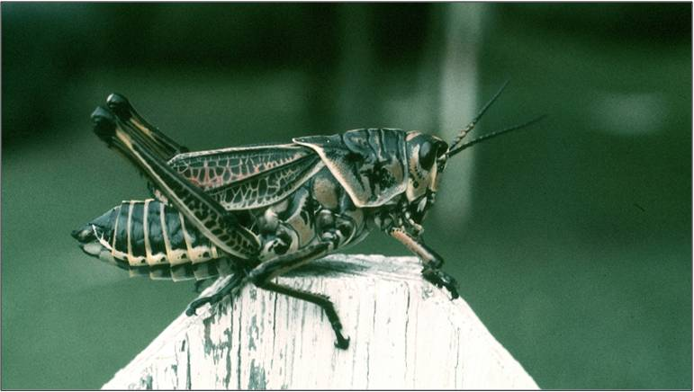
Review of Dichotomous Key Terms
head
1 pair of antennae
abdomen
first pair of legs
thorax
third pair of legs
second pair of legs
Photo Credit:
Jerry A. Payne, USDA Agricultural Research Service, www.bugwood.org, #1224208
Notes:
Grasshopper image:
Note the head, thorax, and abdomen as well as the 3 pairs of legs and 1 pair of antennae. The head will have the antennae, mouthparts, and eyes. The thorax will have the wings and the legs. The abdomen will have the spiracles (holes in the exoskeleton for breathing – no lungs).
Spider image:
Spider bodies are grouped into 2 parts – the cepahlothorax (head and thorax fused together) and the abdomen. The cephalothorax has the mouth, eyes, fangs, pedipalps (used for manipulating food and in adult males as the organ that delivers the sperm to the eggs inside the female), and walking legs. The abdomen has the spinnerets and the breathing apparatus (book lungs). They also have 4 pair of walking legs and no antennae.
Centipede image:
Note the segmented body. There are 1 pair of walking legs per segment and 1 pair of antennae.
Millipede image:
Note the segmented body. There are 2 pair of walking legs per segment and 1 pair of antennae.

Slide 39
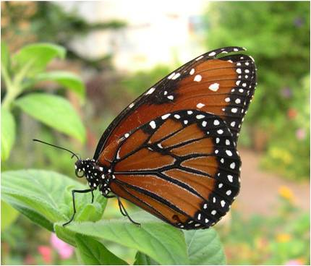
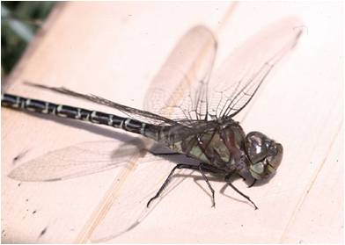
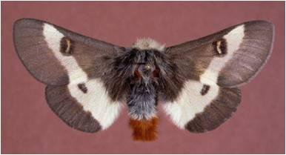
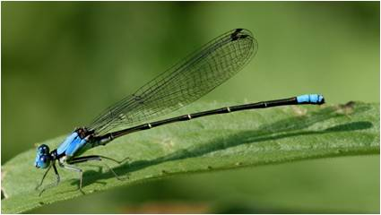
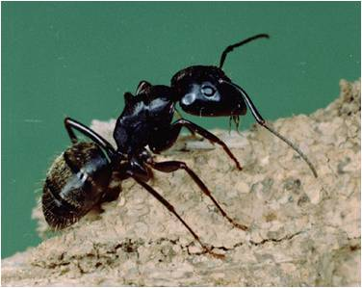
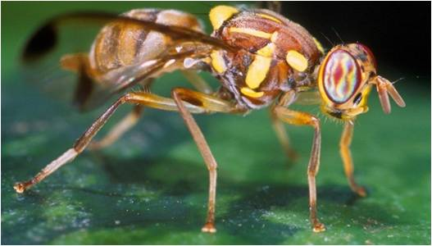
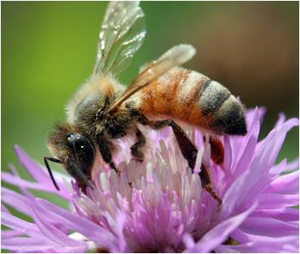
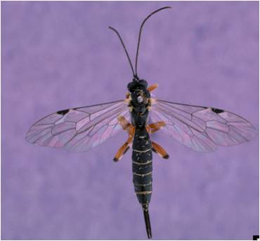
Review of Dichotomous Key Terms
2 pairs of obvious wings
Moths are more chunky and have more hair ↓
← Dragonfly
Damselfly ↓
Butterfly mouthpart
Elbow shaped antennae of wasps, ants, and bees
V-shaped antennae
Narrow waist of wasps, ants, and bees
Fly halteres
Photo Credits:
Butterfly: Stephanie Stocks, University of Florida
Moth: Gerald J. Lenhard, Louisiana State Univ, www.bugwood.org, #0014195
Dragonfly: Edward L. Manigault, Clemson University Donated Collection, www.bugwood.org, #1225012
Damselfly: David Cappaert, Michigan State University, www.bugwood.org, #2158082
Fly: Scott Bauer, USDA Agricultural Research Service, www.bugwood.org, #1317036
Ant: Clemson University - USDA Cooperative Extension Slide Series, www.bugwood.org, #1234159
Wasp: Gerald J. Lenhard, Louiana State Univ, www.bugwood.org, #0014172
Bee: David Cappaert, Michigan State University, www.bugwood.org, #2186092
Hind wings are smaller than forewings in wasps, ants, and bees
Notes:
Butterfly image:
Note the 2 pair of obvious wings and the mouthpart that is curled like a party favor. They have 1 pair of antennae that are slender (some have a hook at the end of their antennae).
Moth image:
Moths are chunkier, hairier, and have 1 pair of antennae (which is usually feathery in appearance). They also have 2 pair of obvious wings.
Dragonfly image:
Note the 2 pair of obvious wings that are the same size and held straight out perpendicular to the body. They have huge eyes compared to the size of their head.
Damselfly image:
Note the 2 pair of obvious wings that are the same size and usually held straight (not folded) alongside the body. They also have huge eyes compared to the size of their head.
Fly image:
Note the 1 pair of obvious wings (the second pair form the halteres) and V-shaped antennae.
Ant image:
Usually seen without their wings (only reproductive adults have them and they only fly a few times a year to establish a new colony somewhere else). They have 1 pair of antennae that are usually bent like an elbow. The waist is narrow and sometimes threadlike.
Wasp image:
Note the 2 pair of obvious wings, the forewings being bigger than the hind wings. They have 1 pair of antennae that are usually bent like an elbow. The waist is narrow and sometimes threadlike.
Bee image:
Note the 2 pair of obvious wings, the forewings being bigger than the hind wings. They have 1 pair of antennae that are usually bent like an elbow. The waist is narrow and sometimes threadlike.

Slide 40
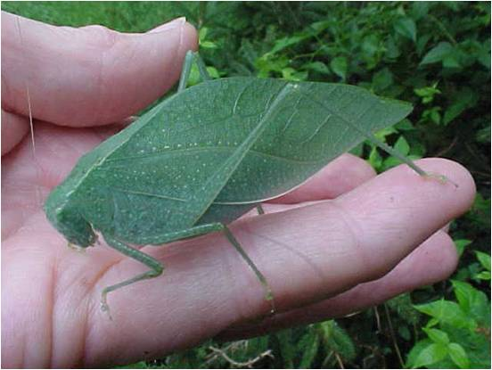
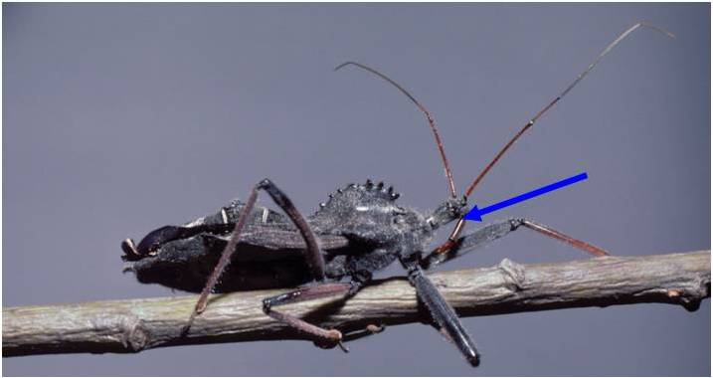






Review of Dichotomous Key Terms
Photo Credit:
Jeanine Soter, www.Bugwood.org, #9009001 and
Gerald J. Lenhard, Louiana State Univ, www.bugwood.org, #0014088 and
Gyorgy Csoka, Hungary Forest Research Institute, www.bugwood.org, #1231089
Piercing, sucking mouthpart at top of the head of true bugs (form 1)
Modified forewings that serve as a protective cover for the hind wings
Photo Credit:
David Riley, University of Georgia, www.bugwood.org, #2511007 and
Clemson University - USDA Cooperative Extension Slide Series, www.bugwood.org, #1435020 and
Gyorgy Csoka, Hungary Forest Research Institute, www.bugwood.org, #1231061
Jumping legs of grasshoppers, katydids, and crickets
Shell like covering that meets in a straight line of beetles
“X” on the back of true bugs (form 1)
Piercing, sucking mouthpart at bottom of head of true bugs (form 2)
Photo Credit:
Larry R. Barber, USDA Forest Service, www.bugwood.org, #0488089 and
Edward L. Manigault, Clemson University Donated Collection, www.bugwood.org, #1225112
Jumping legs
Jumping legs
Jumping legs
Wings held rooflike of true bugs (form 2)
Notes:
Katydid and grasshopper images:
Note the jumping legs, long slender antennae, and what looks like no obvious wings. They are there, but hidden under a cover (which is the forewings).
True bugs (form 1) images:
Note the 1 pair of antennae and the long piercing, sucking mouthpart that begins at the top of the head. Also note the “X” on the backs of the mature true bugs (they don’t get their wings until they are adults). This “X” shape is formed from their forewings being modified and leathery at the base, but membranous at the tip. They are folded on the back and it forms the “X” shape. Their hindwings (which they fly with) are located underneath.
True bugs (form 2) images:
Note the 1 pair of antennae and the short piercing, sucking mouthpart that begins at the bottom of the head. Their forewings are also rather leathery at the base and, membranous at the tips. They hold their wings rooflike over their body.
Beetle images:
Note the 1 pair of antennae and the modified forewings that form a hard shell-like covering over the hindwings which are folded up underneath. The modified forewings form a line down the middle of their back.

Slide 41
Student Activity #2:
“Un-Wanted” Posters
Question:
  What do you think would happen to the biodiversity of a natural ecosystem found in the United States if an exotic pest or disease became established?
  What do you think would happen to our food supply (and our health) if an exotic pest or disease became established in one of our agricultural systems?
  How would you warn the public about it?
Notes:
Language arts and Technology standards can be applied to this activity.

Slide 42
For this assignment…
You will research a plant, animal, or disease that is not found in the United States and then brainstorm what would happen to the biodiversity if it became established in a natural ecosystem or what would happen to our food supply (and health) if it established in an agricultural system.
You may choose a pest or disease that is already known to cause problems in other countries or you can choose any plant or animal that is not already found here (such as hyenas or kangaroos or the European beech tree)
Follow along in Student Handout: “Un-Wanted” Posters

Slide 43
For this assignment…
Questions to be answered:
  To which country is this particular animal, plant, disease, etc. native and is it found anywhere else?
  What habitat would you find this organism (average temperature, average rainfall, etc.)? Do you find a similar habitat here in the United States? If so, where?
  What is the life history of this organism?
    i.e. what does it look like, does it look different at different times in its life (particularly important if it is an insect), when does it become reproductive, what time during the year does it reproduce, how much offspring does it produce, how does it reproduce, how long does it live, does it undergo hibernation, what does it eat, is a similar food source found here, how does it disperse?
  What impact could this organism have on an ecosystem found in the United States?

Slide 44
For this assignment…
Take all the information you have found and put it together as an “Un-Wanted” Poster that you design in PowerPoint.
Size you poster to be 40 inches X 30 inches
Be sure to include images of the organism with your poster.
Be sure to include your references.
Notes:
You can print the poster on 81/2 X 11 paper by clicking on “scale to fit” within the print window.

Slide 45
Student Activity #3:
Computer Lab
Go to the computer lab and complete the e-learning module.
You must create a username and password.
Go through the module and take the quiz at the end.
If you pass with a 70% or better, print out the certificate of completion and turn it in for credit.
  If you did not pass the quiz the first time, you may take the module again.
Notes:
Technology standards can be applied to this activity.

Slide 46
Author Credits and Date of Publication
Stephanie D. Stocks, M.S., Protect U.S. Coordinator, University of Florida
Amanda Hodges, PhD, Department of Entomology and Nematology, University of Florida
September 2011
Updated June 2012

Slide 47
Reviewers Credits
Todd Dutton, M.S., Supervisory Training Specialist/ Plant Health Safeguarding (PHS) Unit, USDA APHIS PPQ PDC
Brian E. Myers, PhD, Agricultural Education and Communication, University of Florida
Jean Dickey, PhD, Department of Biological Sciences, Clemson University
Jennifer Weeks, PhD, Department of Entomology and Nematology, University of Florida

Slide 48
Educational Disclaimer and Citation
This presentation can be used for educational purposes for NON-PROFIT workshops, trainings, classrooms, etc.
Citation:
  S. Stocks and A. Hodges. 2011. Biodiversity,
  Invasive Species, and Plant Biosecurity (add the date accessed) - www.protectingusnow.org

Slide 49

Our Partners
Much of the authorship of e-learning content has occurred through partnerships. Some of our partnering organizations have included:

Slide 50
References
ABS- CBN News. “Deadly E. coli in Germany: a timeline”. accessed June 12, 2012 –
  http://www.abs-cbnnews.com/lifestyle/06/10/11/deadly-e-coli-germany-timeline
Alabama Forestry Commission. “Laurel Wilt Disease”. accessed 6/14/2012 –
  http://www.forestry.alabama.gov/LaurelWilt.aspx?bv=3
Allaby, M., editor. Concise Oxford Dictionary of Ecology. 1998. Oxford University Press, USA California Biodiversity Council. Accessed June 15, 2012 –
  http://biodiversity.ca.gov/Biodiversity/biodiv_def2.html
Arizona Department of Health Services. Bureau of Emergency Preparedness and Bioterrorism. “History of Biowarfare and Bioterrorism”. Accessed June 17, 2012-
  http://www.azdhs.gov/phs/edc/edrp/es/bthistor2.htm
Asian Longhorned Beetle website. accessed June 5, 2012 –
  http://www.uvm.edu/albeetle/management/treeremoval.html
BBC News. “Spain seeks compensation for E. coli blame”. accessed June 12, 2012 -
  http://www.bbc.co.uk/news/mobile/world-europe-13637130?index.shtml??PDA=1%3FPDA=1%253Fcategory=films
California Oak Mortality Task Force. 2012. accessed 6/14/2012 –
  http://www.suddenoakdeath.org/diagnosis-and-management/hosts-and-associated-plants/

Slide 51
References
Caribbean Pest Information Network Pest Alerts. accessed June 17, 2012 –
  http://www.caripestnetwork.org/vtt/docs/datasheets/fungi/snchytrium_endobioticum.pdf
Carus, W.S. 2002. Bioterrorism and Biocrimes: The Illicit Use of Biological Agents since 1900. accessed June 17, 2012-
  http://books.google.com/books?id=1jEP8Ve4zwgC&printsec=frontcover&dq=bioterrorism+and+biocrimes&hl=en&ei=Ow0mTfSNJIK88gbftvCWAQ&sa=X&oi=book_result&ct=result&resnum=1&ved=0CCsQ6AEwAA#v=onepage&q&f=false
Centers for Disease Control and Prevention. “Anthrax”. accessed June 17, 2012 –
  http://www.bt.cdc.gov/agent/anthrax/
Centers for Disease Control and Prevention. “Fruit and Vegetable Benefits”. Accessed June 15, 2012 -
  http://www.fruitsandveggiesmatter.gov/benefits/index.html
Centers for Disease Control and Prevention. “Glanders”. Accessed June 17, 2012 –
  http://www.cdc.gov/nczved/divisions/dfbmd/diseases/glanders/
Center on Globalization Governance and Competitiveness. “A Value Chain Analysis of the U.S. Beef and Dairy Industries”. accessed June 17, 2012 –
  http://www.cggc.duke.edu/environment/valuechainanalysis/CGGC_BeefDairyReport_2-16-09.pdf

Slide 52
References
Convention on Biological Diversity. accessed June 15, 2012 –
  http://www.biodiv.be/biodiversity/about_biodiv/importance-biodiv/
Croddy, E., J. Wirtz, and J. Larsen, editors. 2004. Weapons of Mass Destruction, an Encyclopedia of Worldwide Policy, Technology, and History. accessed June 17, 2012 –
  http://books.google.com/books?id=ZzlNgS70OHAC&printsec=frontcover&dq=weapons+of+mass+destruction+and+encyclopedia&hl=en&ei=bg0mTaj8LMSp8Aa3xeiNAg&sa=X&oi=book_result&ct=result&resnum=1&ved=0CCMQ6AEwAA#v=onepage&q&f=false
Ecological Society of America. accessed June 15, 2012 –
  http://www.esa.org/education_diversity/pdfDocs/biodiversity.pdf
Emerald ash borer website. accessed June 5, 2012 –
  http://www.emeraldashborer.info/
EPPO Data Sheets on Quarantine Pests. “Anoplophora glabripennis”. accessed June 6, 2012 –
  http://www.eppo.int/QUARANTINE/insects/Anoplophora_glabripennis/ANOLGL_ds.pdf
EPPO Data Sheets on Quarantine Pests. “Synchytrium endobioticum”. accessed June 17, 2012 –
  http://www.eppo.org/QUARANTINE/fungi/Synchytrium_endobioticum/SYNCEN_ds.pdf

Slide 53
References
Florida Department of Agriculture and Consumer Service, Division of Forestry. 1999. Forest Trees of Florida. Published in house.
Florida Department of Agriculture and Consumer Services – Division of Forestry. 2008. accessed 6/14/2012 –
  http://www.floridaforestservice.com/publications/fh_pdfs/Laurel_Wilt.pdf
Florida Department of Agriculture and Consumer Services – Division of Plant Industry Pest Alert. “ Citrus Greening/Huanglongbing)”. accessed June 17, 2012 –
  http://www.freshfromflorida.com/pi/pest-alerts/huanglongbing.html
Florida Department of Agriculture and Consumer Services – Office of Agricultural Emergency Preparedness. Accessed June 15, 2012 –
  http://www.freshfromflorida.com/aep/
Fraedrich, S.W., T.C. Harrington, R.J. Rabaglia, M.D. Ulyshen, A.E. Mayfield, III, J.L. Hanula, J.M. Eickwort, and D. R. Miller. 2008. “A Fungal Symbiont of the Redbay Ambrosia Beetle Causes a Lethal Wilt in Redbay and Other Lauraceae in the Southeastern United States”. Plant Disease, Volume 92, No. 2.

Slide 54
References
Garrett, B.C. 1996. “The Colorado Potato Beetle Goes to War”. Historical Note No. 2. accessed June 17, 2012-
  http://www.sussex.ac.uk/Units/spru/hsp/documents/CWCB33-Garrett.pdf
Garbelotto, M. 2004. “Sudden oak Death: A Tale of Two Continents”. Outlooks on Pest Management, Volume 15, Number 2, pp. 85-89.
Gottwald, T.R. J.V. Garca, and R.B. Bassanezi. 2007. “Citrus Huanglongbing: The Pathogen and Its Impact”. Plant Health Progress. accessed June 17, 2012 –
  http://www.apsnet.org/publications/apsnetfeatures/Pages/HuanglongbingImpact.aspx
Gullino, M.L., J. Fletcher, and J.P. Stack. 2008. Crop biosecurity: definitions and role in food safety and food security. In Crop Biosecurity: Assuring our Global Food Supply. Gullino, M.L., J. Fletcher, A. Gamliel, J.P. Stack. (eds).
Halbert, S. 2004. Pathways for the introduction of exotic pests: a Florida perspective. Entomological Society of America Annual Conference, Salt Lake City, UT. Abstract. Accessed June 15, 2012 -
  http://esa.confex.com/esa/2004/techprogram/paper_14325.htm
Hale, W. G. and J.P. Margham. 1991. The Harper Collins Dictionary of Biology. Harper Perennial, New York.

Slide 55
References
Homeland Security News Wire. 2009. Accessed June 15, 2012 –
  http://www.homelandsecuritynewswire.com/improving-inspections-agricultural-products
Iowa State University. Center of Food Security and Public Health. “Rinderpest”. accessed June 17, 2012 –
  http://www.cfsph.iastate.edu/Factsheets/pdfs/rinderpest.pdf
Karasik, T.W. 2002. Toxic Warfare . accessed June 17, 2012 –
  http://books.google.com/books?id=zoDbDBsAMHIC&printsec=frontcover&dq=toxic+warfare&hl=en&ei=sg0mTdb1DIO78gaWjYnXAQ&sa=X&oi=book_result&ct=result&resnum=1&ved=0CCYQ6AEwAA#v=onepage&q&f=false
Lockwood, J.L., M.F. Hoopes, and M.P. Marchetti. Invasion Ecology. 2007. Wiley-Blackwell, Malden, MA.
Murphy, P.J. 2004. The Wolves of Islam: Russia and the Faces of Chechen Terror. Brassey’s, Inc., Dulles, Virginia.
National Economic Impact of the U.S. Horse Industry. accessed June 17, 2012-
  http://www.floridahorse.com/2005ahcstudy.html
National Invasive Species Council. Accessed June 15, 2012 –
  http://www.invasivespecies.gov/

Slide 56
References
National Plant Diagnostic Network First Detector Modules - Introduction to the Emerald Ash Borer and Identification and Hosts. accessed June 5, 2012 –
  http://www.firstdetector.org
National Select Agent Registry. Accessed June 15, 2012 –
  http://www.selectagents.gov/FAQ_General.html#sec1q3
Oregon State University Extension Service. “Gumming Disease and Rye Grass Toxicity”. accessed June 17, 2012 -
  http://www.science.oregonstate.edu/bpp/Plant_Clinic/Disease_sheets/Rathayibacter%20toxicus.pdf
Oxford Advanced Learner’s Dictionary. Accessed June 15, 2012 –
  http://www.oxfordadvancedlearnersdictionary.com/dictionary/biosecurity
Parker, R., C. Mathis, M. Looper, J. Sawyer. “Anthrax and Livestock”. New Mexico State University College of Agriculture and Home Economics. accessed June 17, 2012 –
  http://aces.nmsu.edu/pubs/_b/B-120.pdf

Slide 57
References
Paysant. D. “Seven French children hospitalised by E. coli outbreak”. accessed June 17, 2012 –
  http://www.google.com/hostednews/afp/article/ALeqM5jpYKGWrs-RUe1mTEGSEkze5tontw?docId=CNG.7f55475450cb72752302481aad82821f.d21
Pimental, D., R. Zuniga, and D. Morrison. 2004. Update on the environmental and economic costs associated with invasive species in the United States. Ecological Economics. 52: 273-288.
Protect U.S. scripted presentation. “Citrus Greening and the Asian Citrus Psyllid”. Accessed June 17, 2012 –
  http://www.protectingusnow.org
Recovery Plan For Rathayibacter Poisoning Caused by Rathayibacter toxicus (syn. Clavibacter toxicus). accessed June 17, 2012 –
  http://www.ars.usda.gov/SP2UserFiles/Place/00000000/opmp/RathayibacterPoisoningFeb2010.pdf
Redmond, C., M.J. Pearce, R.J. Manchee, and B.P. Berdal. 1998. Deadly Relic of the Great War”. Nature, vol. 393, pp. 747-748. accessed June 17, 2012 –
  http://www.nature.com/nature/journal/v393/n6687/full/393747a0.html

Slide 58
References
Scientific Correspondence. “First Shots Fired in Biological Warfare”. Nature, vol. 395, p. 213. accessed June 17, 2012 –
  http://www.nature.com/nature/journal/v395/n6699/pdf/395213a0.pdf
Shiflett, Julie Stepanek. 2008. Sheep Industry Economic Impact Analysis. Prepared for the American Sheep Industry Association.
Srinivasan, A., C.N. Kraus, P.M. Becker, J.D. Dick, L. Spacek, J.G. Bartlett, and D.L. Thomas. 2001. “Glanders in a Military Reseach Microbiologist”. The New England Journal of Medicine. accessed June 17, 2012 -
  http://www.nejm.org/doi/full/10.1056/NEJM200107263450404
Sumner, D. A. 2003. “Exotic Pests and Public Policy for Biosecurity: An introduction and Overview”, in Exotic Pests and Diseases: Biology and Economics for Biosecurity, edited by Daniel A. Sumner, Iowa State Press.
The Learning Channel. accessed June 15, 2012 -
  http://recipes.howstuffworks.com/fresh-ideas/healthy-dinners/health-benefits-of-dairy-ga.htm

Slide 59
References
University of Florida Featured creatures – “Brown Marmorated Stink Bug”. Accessed June 6, 2012 –
  http://entnemdept.ufl.edu/creatures/veg/bean/brown_marmorated_stink_bug.htm
University of Maryland Extension Service – “Brown Marmorated Stink Bug”. accessed June 17, 2012 –
  http://www.hgic.umd.edu/content/brownstinkbug.cfm
University of Minnesota Center for Infectious Disease Research and Policy. “Overview of Agricultural Biosecurity”. accessed June 17, 2012 –
  http://www.cidrap.umn.edu/cidrap/content/biosecurity/ag-biosec/biofacts/agbiooview.html
USDA – APHIS. 2012. accessed 6/14/2012
  http://www.aphis.usda.gov/plant_health/plant_pest_info/pram/downloads/pdf_files/nationalpestalert_.pdf
USDA-APHIS-PPQ guidelines for pathway surveys. Accessed June 15, 2012 –
  http://caps.ceris.purdue.edu/guidelines/2011/nsg
USDA-ARS Potato Wart Disease Recovery Plan. accessed June 17, 2012-
  http://www.ars.usda.gov/SP2UserFiles/Place/00000000/opmp/PotatoWart70109.pdf
USDA Chose my Plate. Accessed June 15, 2012 -
  http://www.choosemyplate.gov

Slide 60
References
USDA Natural Resources Conservation Service – Plant Database. “Acer”, “Betula”, “Aesculus”, “Ulmus”, “Salix”. accessed June 6, 2012 –
  http://plants.usda.gov/
USDA Natural Resources Conservation Service – Plant Database. “Fraxinus”. accessed June 6, 2012 –
  http://plants.usda.gov/
USDA News and Events. “Combating the Brown Marmorated Stink Bug: A New Threat for Agriculture, a Nuisance for Homeowners”. accessed June 5, 2012 –
  http://www.ars.usda.gov/is/AR/archive/jul09/bug0709.htm
USDA Pest Alert. “Asian Longhorned beetle”. accessed June 5, 2012 –
  http://www.na.fs.fed.us/pubs/palerts/alb/alb_pa.pdf
USDA Pest Alert. “Emerald Ash Borer”. accessed June 5, 2012 –
  http://www.na.fs.fed.us/spfo/pubs/pest_al/eab/eab04.htm
US Environmental Protection Agency. accessed June 15, 2012 –
  http://www.epa.gov/bioiweb1/aquatic/
WebMD. accessed June 15, 2012 -
  http://www.webmd.com/fitness-exercise/guide/benefits-protein

Slide 61
References
Webster, S., editor. 2004. The Hutchinson Pocket Dictionary of Biology, Helicon Publishing.
USDA Economic Research Service. Accessed June 5, 2012 –
  Fruit and Tree nut Yearbook - http://usda.mannlib.cornell.edu/usda/ers/./89022/2009/index.html
  Vegetable and Melons Yearbook - http://usda.mannlib.cornell.edu/MannUsda/viewDocumentInfo.do?documentID=1212
  Livestock and Dairy - http://www.ers.usda.gov/publications/ldp/LDPTables.htm
  Wheat - http://www.ers.usda.gov/data/wheat/YBtable01.asp
  Spinach - http://www.ers.usda.gov/News/spinachcoverage.htm
  Bell peppers, onions, and tomatoes - http://www.ers.usda.gov/Catalog/CatalogByTopicID.asp?SON=TRUE&SBY=TITLE&PDT=1&ARC=C&TID=660
  cheese - http://future.aae.wisc.edu/data/annual_values/by_area/178?tab=production and http://www.fas.usda.gov/psdonline/circulars/Dairy.pdf
  Pork - http://www.ers.usda.gov/Publications/AgOutlook/AOTables/
  Rye data - http://www.ers.usda.gov/data/wheat/YBtable02.asp
USDA – Forest Service. “Kudzu”. Accessed June 15, 2012 –
  http://www.invasive.org/weedcd/pdfs/wow/kudzu.pdf

